Slide 1

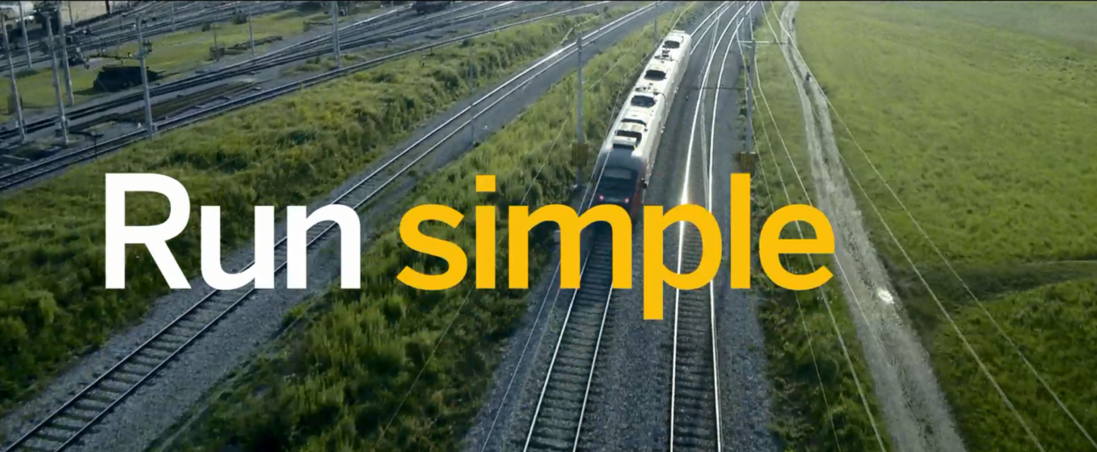


SAP UA Summer Workshop – Milwaukee Business Analytics June 20 - 24, 2016 Hossam Ali-Hassan, Dalhousie University

Slide 2
Agenda for Monday June 20, 2016
Start | End | Topic | Description
9:00 | 9:30 | Welcome and introductions | General introductions, agenda
9:30 | 10:30 | UA Teaching resources, Analytics BI/BW curriculum, Data Sources | Where to find curriculum, updates and discussions
10:30 | 10:45 | Break
10:45 | 12:00 | SAP BW Data Modeling, GBI InfoCube, dimensions and fact tables, ETL of master data | Demo
12:00 | 13:00 | Lunch break
13:00 | 13:45 | Self-serve analytics: GBI on HANA | Hands on exercises on ERP system in HANA
13:45 | 14:30 | Reporting on SAP BW, BEx Query Designer | Hands on exercises in BEx Query Designer
14:30 | 14:45 | Break
14:45 | 15:45 | Reporting on SAP BW, BEx Query Designer (cont.) | Hands on exercises in BEx Query Designer cont.
15:45 | 17:00 | HANA, in-memory databases, Hadoop | Discussion and Hadoop class activity

Slide 3

About Me
Hossam Ali-Hassan
Associate Professor of MIS
Rowe School of Business
Dalhousie University
Halifax, Nova Scotia
Canada
Computer Engineering, MBA, PhD in MIS
Teaching MIS courses since 1998
Use SAP ERPsim in classes
Attended Analytics with SAP workshop in June 2014
Taught Business Analytics course past two years
SAP Lumira, Predictive Analytics, BO Analysis, …

Slide 4
Introductions
Name
School/Department
Background related to analytic applications
Purpose of workshop attendance

Slide 5
Workshop Objectives
Learn about analytics applications from SAP
Discover where to find resources for teaching with SAP analytics solutions
Acquire a bit of background information on in-memory and distributed database solutions
Gain experience working through curricula available for UA members
Test drive SAP analytical tools
SAP Business Warehouse (BW)
BEx Query Designer
SAP BusinessObjects Analysis
SAP Predictive Analytics:
Lumira
Infinite Insight (Automated Mode)
Expert Analysis
SAP BusinessObjects Design Studio

Slide 6
Acronyms (good to know)
SAP S/4 HANA – SAP Business Suite 4 SAP HANA
SAP UA – SAP University Alliances
UAC – SAP University Alliances Community – scn.sap.com/community/uac
APJ – Asia Pacific Japan
NA/LA – North America/ Latin America
EMEA – Europe, Middle East, Africa
DACH – Germany, Austria, Switzerland
UCC – University Competence Center (Chico, UWM, Magdeburg, Munich, QUT)
GBI – Global Bike Inc. (model company)
ERP – Enterprise Resource Planning
SAP BW – SAP Business Warehouse
SAP HANA – SAP High Performance Analytic Appliance (in-memory database)
SCN – SAP Community Network – scn.sap.com
BOBJ – SAP BusinessObjects
JAM - SAP's cloud-based social media platform, for collaborating

Slide 7

SAP Data Analytics

Slide 8
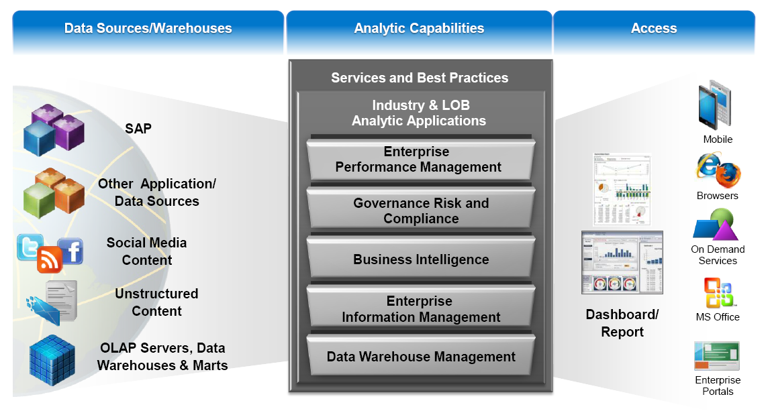
Analytics: Sources-Capabilities-Access

Slide 9
SAP Analytics Tools Overview
SAP
SAP Crystal
Web Intelligence
Analysis
Design Studio
Predictive Analytics
Crystal Reports
Crystal Dashboard Design
Cloud
Lumira
Analytics Applications
SAP BusinessObjects
Business Explorer (BEx)
Visual Business
Data sources and Data Staging
Business Warehouse : SAP Netweaver BW
High-Performance In-Memory Appliance SAP HANA
Business Suite
Non-SAP

Slide 10
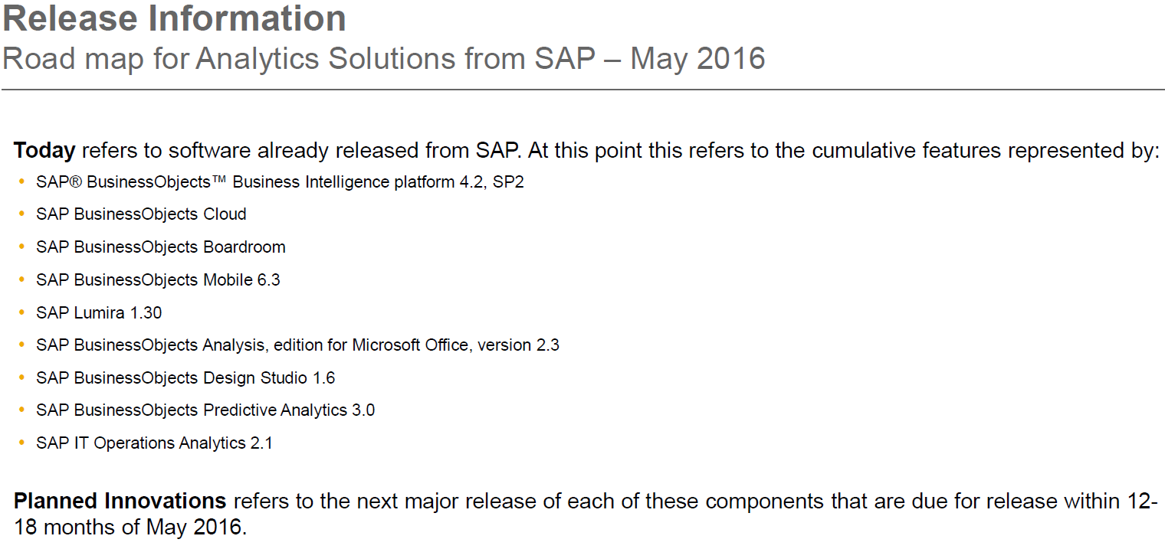

Slide 11
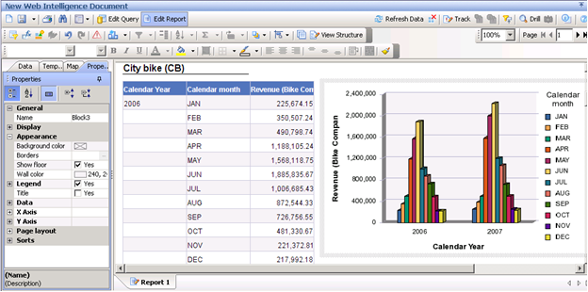
SAP BusinessObjects Web Intelligence aka WebI
Intuitive Web-based interface with offline capabilities
Ad Hoc Query, reporting and analysis
Multi-source access
Filtering, ranking, sorting, alerting, breaks and sections
Business-centric view of information with Universes

Slide 12
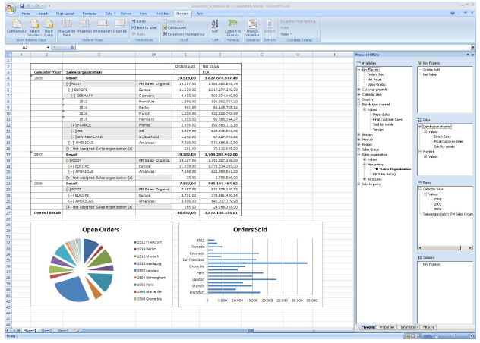
SAP BusinessObjects Analysis
OLAP data access
Available in various editions – Web, Excel and PowerPoint
Multiple OLAP cubes in the same workspace
Optimized for highly interactive analysis
Several visualization options (scatter charts, radar charts etc.)
Exception highlighting
Drill-down capability
Ideal for power user

Slide 13
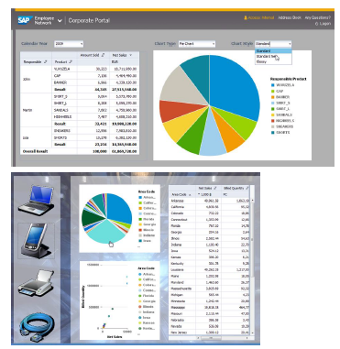
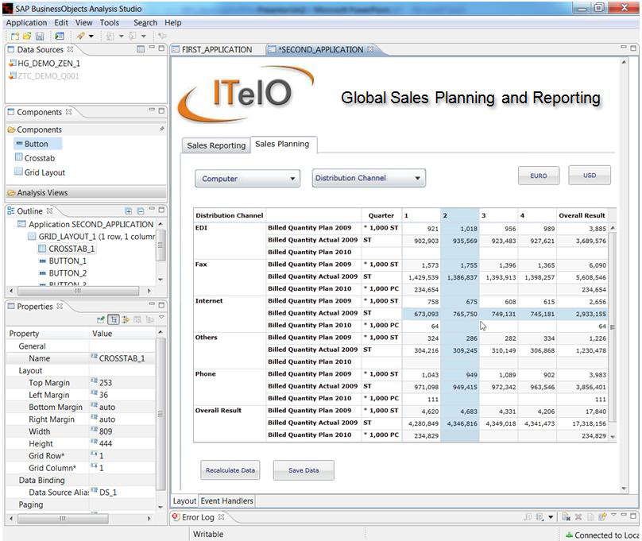
SAP BusinessObjects Design Studio
Replacement for BEx Web Application Designer
Easily design centrally governable analytic content ranging from simplified templates via guided analytics to sophisticated applications.
Intuitive WYSIWYG design environment for designers
Large set of design components (buttons, tabs, dropdown menus etc.)
Extend via scripting language (subset of JavaScript)
Central Supportability
Theming & Customizing
iPad Support built-in
Apps are ready for immediate usage on standard web browsers and mobile devices (HTML5)
Direct & native support for HANA & BW
Operates directly on BEx Queries, InfoCubes and Hana Views
Support for BW & HANA

Slide 14
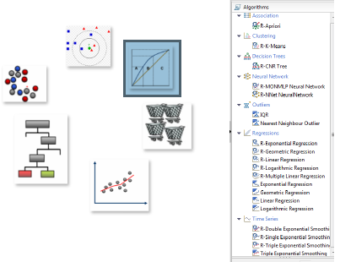
SAP BusinessObjects Predictive Analytics (including Lumira)
SAP Predictive Analytics consists of two data mining tools
Automated Analytics – a set of automated data mining algorithms. This product used to be called Infinite Insight
Expert Analytics – User controlled data mining models and advanced visualization (with Lumira desktop). This product used to be called SAP Predictive Analysis
Designing complex predictive models (data mining)
Data visualization, discovery and insights
Open-source predictive algorithms via integration with R

Slide 15
SAP BusinessObjects Cloud (formerly know as Cloud for Analytics C4A)
SAP BusinessObjects Cloud is a Software-as-a-Service (SaaS) built on SAP HANA Cloud Platform (HCP) that provides analytics, planning and predictive capabilities.
Data modeling and exploration
Data visualization
Story creation
Integrated planning
Some predictive algorithms
Collaboration

Slide 16
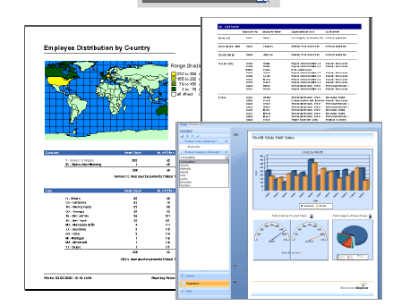
SAP Crystal Reports
Standard tool for reporting
Build any kind of report –such as business, financial, legal, and regulatory reports
Sophisticated report formatting: create multi-page, multi-query, pixel-perfect reports
Templates and wizards to speed up report creation
Secure, large-scale distribution of reports over the Web
Connectivity to any data source

Slide 17
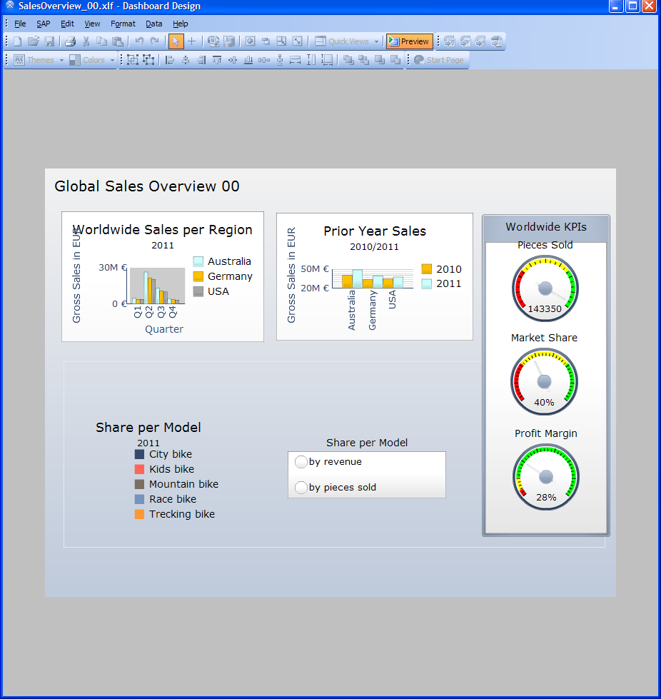
SAP Crystal Dashboard Design aka SAP BusinessObjects Dashboards aka Xcelsius
Personalized dashboard online and offline
Flash-based interactive dashboards
Visualize anywhere – portal, reports, PDF, MS Office, Flash
Powerful “what-if” analysis with input controls (sliders, dials etc.)
Drill-down capability
Stunning graphics with skins, maps, charts, gauges and selectors
Integration with SAP BW InfoCubes
NO MORE DEVELOPMENT. Do not use!

Slide 18
Resources
SAP University Alliances Analytics Site http://scn.sap.com/community/uac/business-intelligence-library
SAP Analytics space http://scn.sap.com/community/business-intelligence
Tutorials http://www.sdn.sap.com/irj/boc/bi-suite-tutorials http://scn.sap.com/docs/DOC-7725
Book http://www.sap-press.com/products/Integrating-SAP-BusinessObjects-BI-Platform-4.x-with-SAP-NetWeaver.html
SAP BusinessObjects Analysis http://scn.sap.com/community/businessobjects-analysis-ms-office
SAP Predictive Analysis http://scn.sap.com/community/predictive-analysis
SAP HANA http://www.saphana.com/welcome

Slide 19

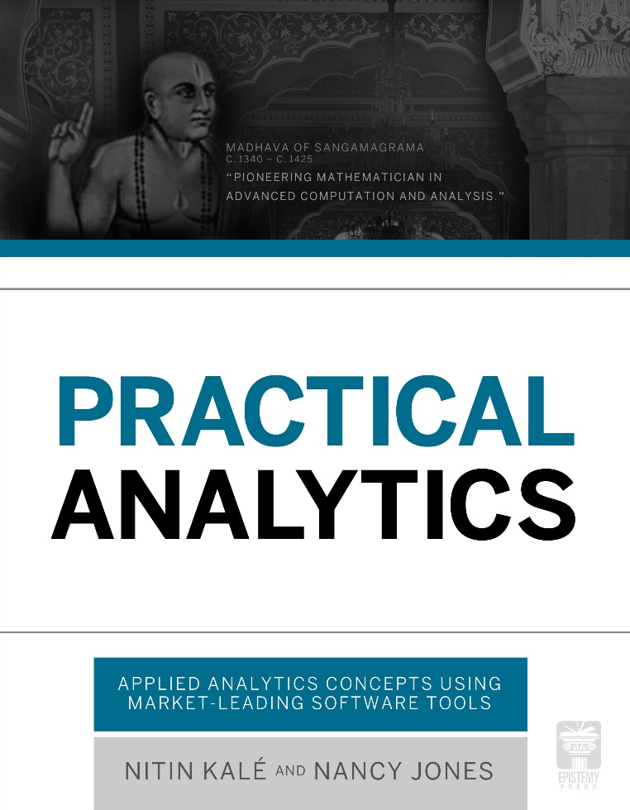
Practical Analytics by Nitin Kale, Nancy Jones
An excellent resource for teaching Analytics with SAP
http://www.epistemypress.com/books/practical-analytics/
To request a faculty review copy: http://epistemypress.com/pasample/

Slide 20

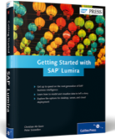
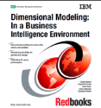
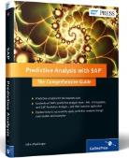
Other Books I Also like for Analytics
Business Intelligence: A Managerial Perspective on Analytics, by Ramesh Sharda, Dursun Delen, and Efraim Turban. 3rd Edition, 2014, Prentice Hall.
Dimensional Modeling: In a Business Intelligence Environment, by Chuck Ballard, Daniel M. Farrell, Amit Gupta, Carlos Mazuela, and Stanislav Vohnik, IBM Redbooks, 2006
Getting Started with SAP Lumira, by Christian Ah-Soon, Peter Snowdon, 2014, SAP Press
Predictive Analysis with SAP: The Comprehensive Guide, John MacGregor, 2013, SAP Press

Slide 21
Analytics curriculum from SAP University Alliances and other resources

Slide 22
What’s available? SAP University Alliances Program Analytics Curriculum
SAP UA curriculum is available on the SAP Learning Hub. Please do not use the old site on scn.sap.com https://jam2.sapjam.com/groups/about_page/11mofEXLDOzgNyv1RrCf4C
Data Foundation using SAP Netweaver BW
Analytics Application using SAP BusinessObjects and SAP Crystal Solutions
Analytics Applications
SAP BusinessObjects
Business Warehouse
SAP Netweaver BW
SAP Crystal Solutions
Web Intelligence
Analysis
Design Studio
Predictive Analysis
Crystal Reports
Crystal Dashboard Design
In-Memory Computing
High-Performance In-Memory Appliance HANA
Cloud
SAP Business Explorer (Bex)
Lumira

Slide 23
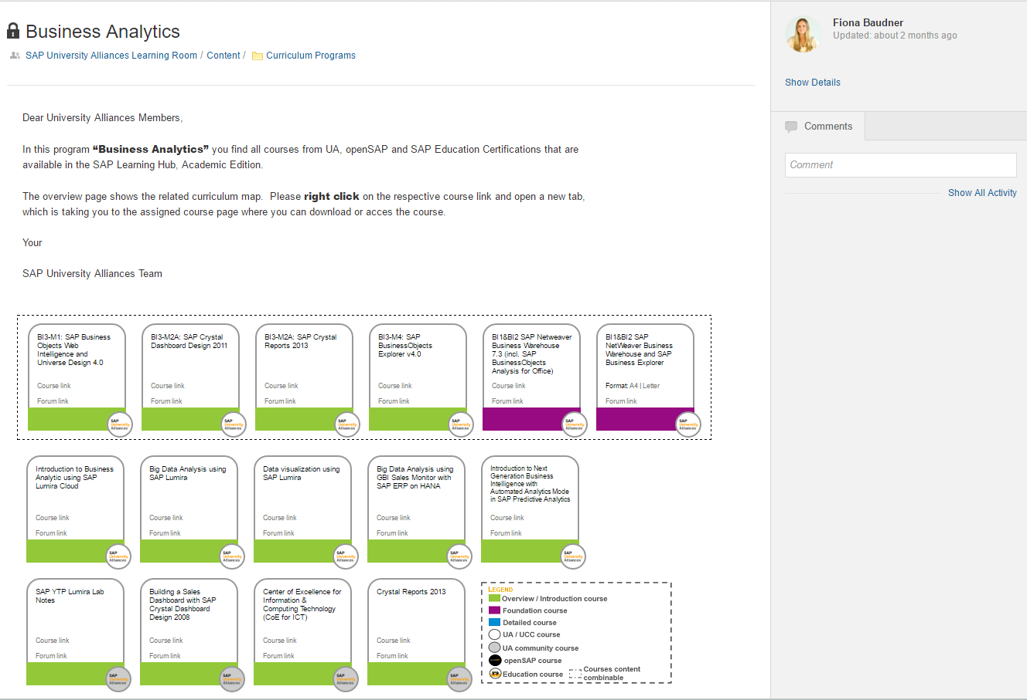
Navigation to Analytics Course Library
https://jam2.sapjam.com/wiki/show/ZHUSiGuWIlZKT8drWGBpA0?_lightbox=true

Slide 24
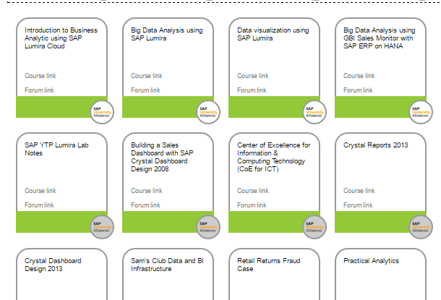
Curricula Links

Slide 25
Three levels of curricula | Three sources of curricula
Introductory courses
Data Foundation courses
Detailed courses
UA created courses
UA Community contributed courses
OpenSAP courses

Slide 26
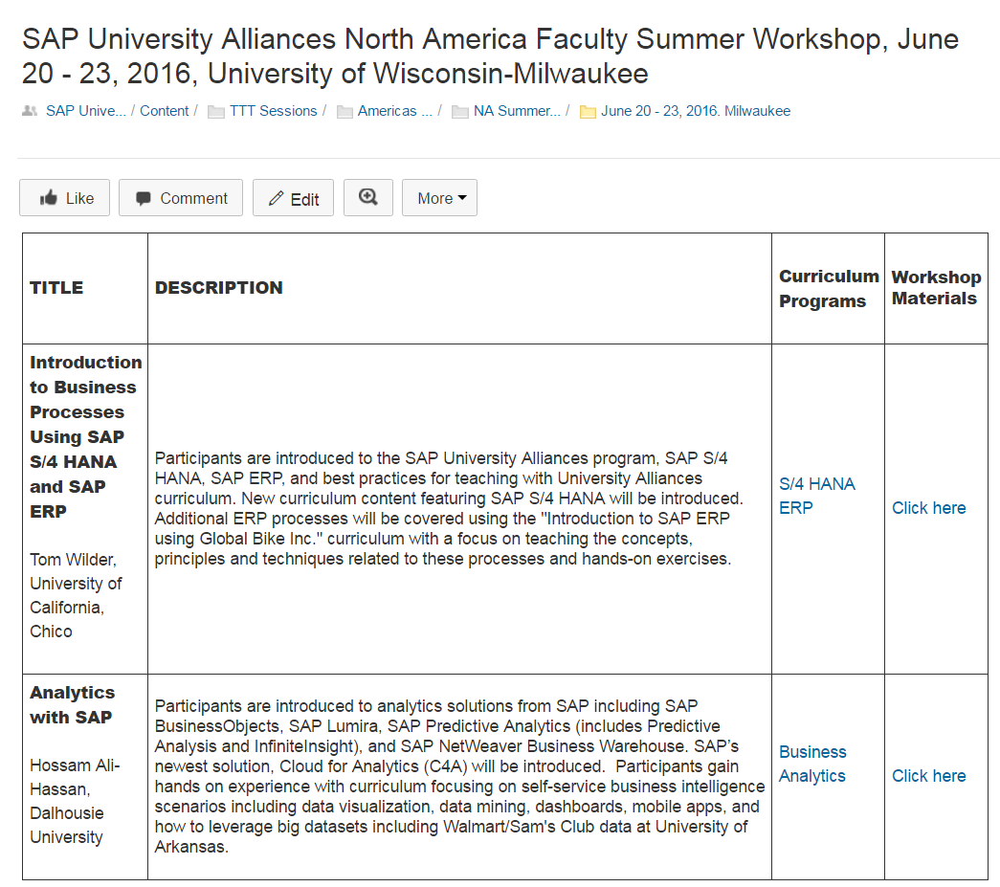
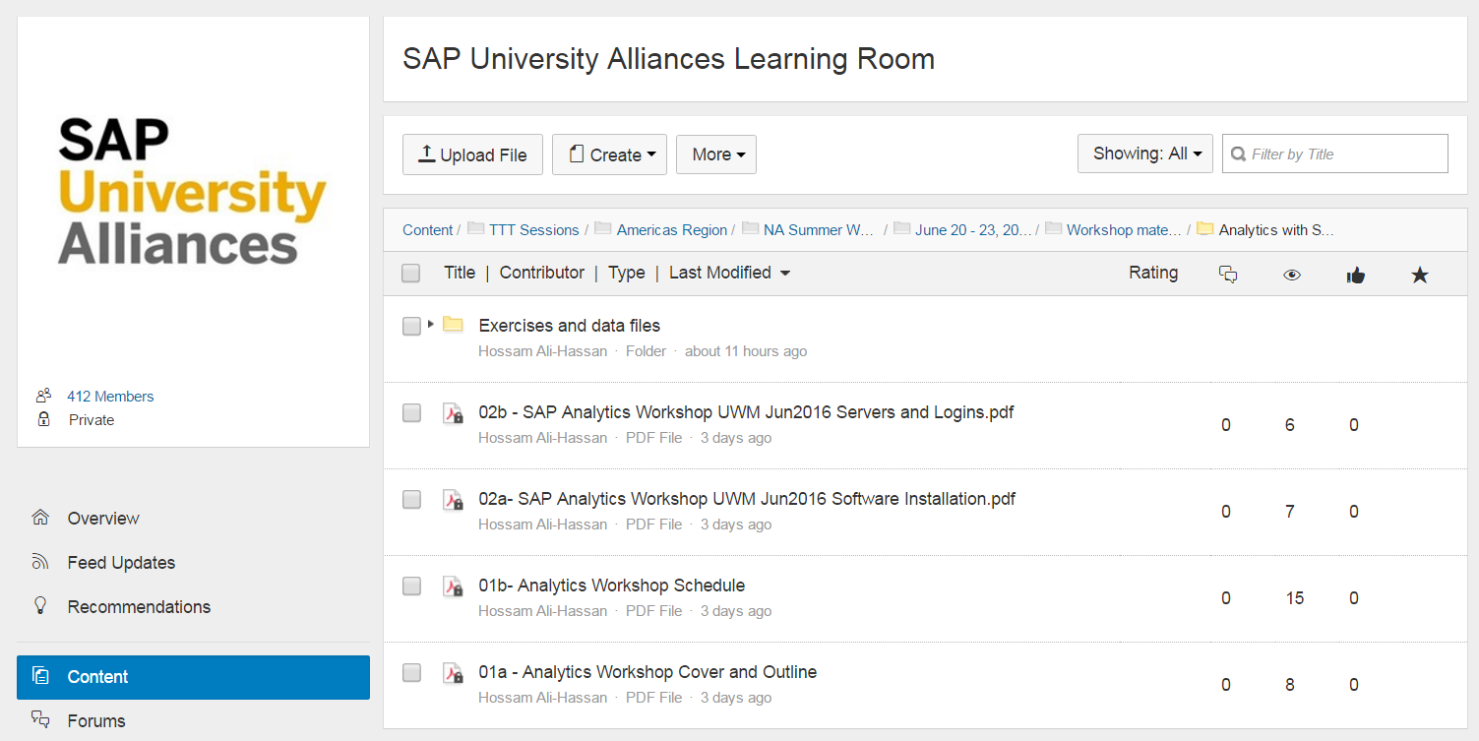
Where to find the materials for this workshop?
https://jam2.sapjam.com/wiki/show/TJwf8Mg4HmZUHYAuzhKUok
Workshops at various SAP UA events have their own discussion thread. Workshop materials are posted in the thread

Slide 27
Where to find software?
Your UCC will provide you a URL and access to the software download page.
Note that software versions change often so check the download site for the latest version
Some software is also available on a trial basis from sap.com
Most software runs only on Windows (this has implications for your lab setup and your students’ laptops)
Note that software has dependencies on your operating system, number of bits, version of Microsoft Office, JAVA etc.
Some schools such as USC have implemented a “Virtual Lab” where all software is installed on remote servers so that students can remote desktop in (from both Windows and MAC) – BYOLaptop – Less investment in “labs”

Slide 28
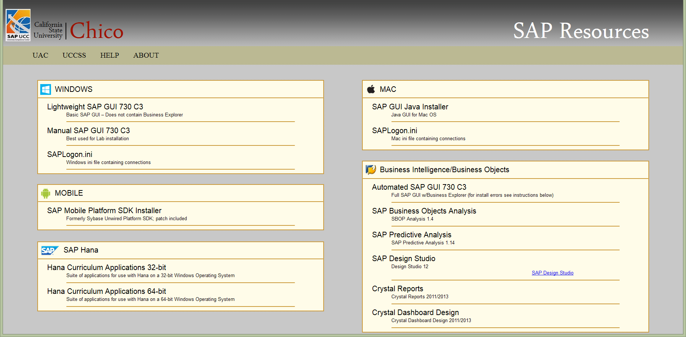
Software download site at UCC Chico
http://worker.cob.csuchico.edu/ user: sap password: sapgui4me
For license keys, go to http://scn.sap.com/docs/DOC-45789

Slide 29
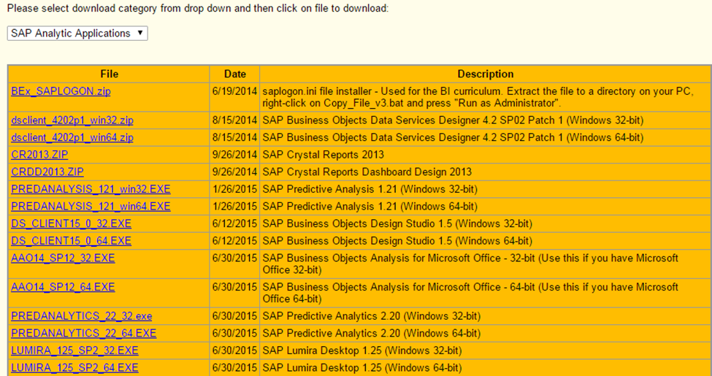
Software download site at UCC UWM
For license keys, go to http://scn.sap.com/docs/DOC-45789

Slide 30

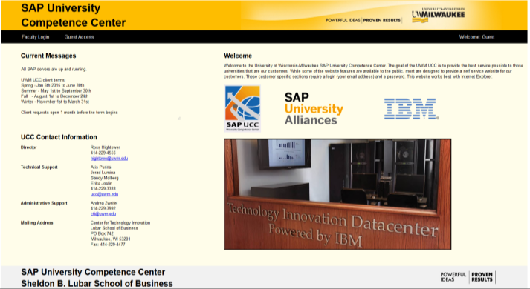
How to request system access?
http://sap.cob.csuchico.edu/
or
http://ucc.uwm.edu/
Go to your UCC’s website and request system access for HANA, BW and Business Objects Explorer

Slide 31

How to request system access?
http://walton.uark.edu/enterprise/
Go to University of Arkansas – Walton College of Business

Slide 32
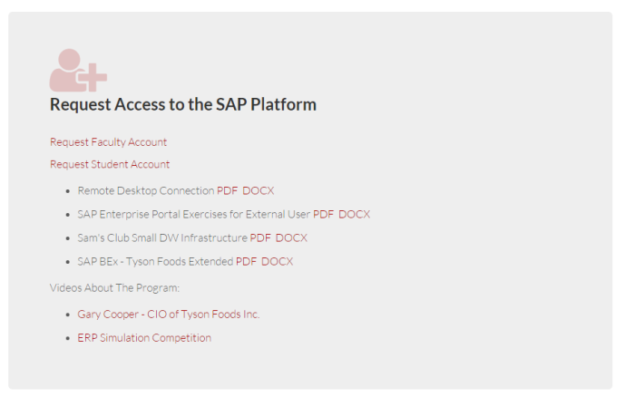
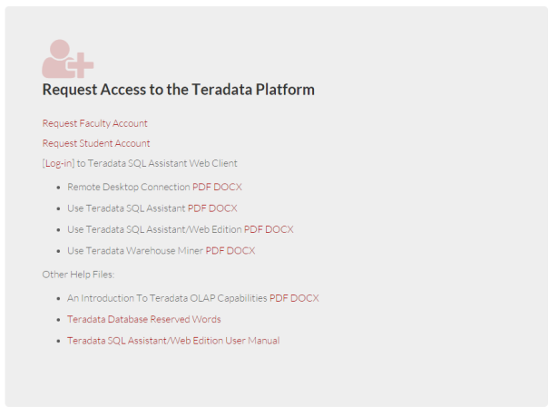
To Request Access to UArk systems
http://walton.uark.edu/enterprise/sap-university-alliance.php
http://walton.uark.edu/enterprise/teradata-university-network.php

Slide 33
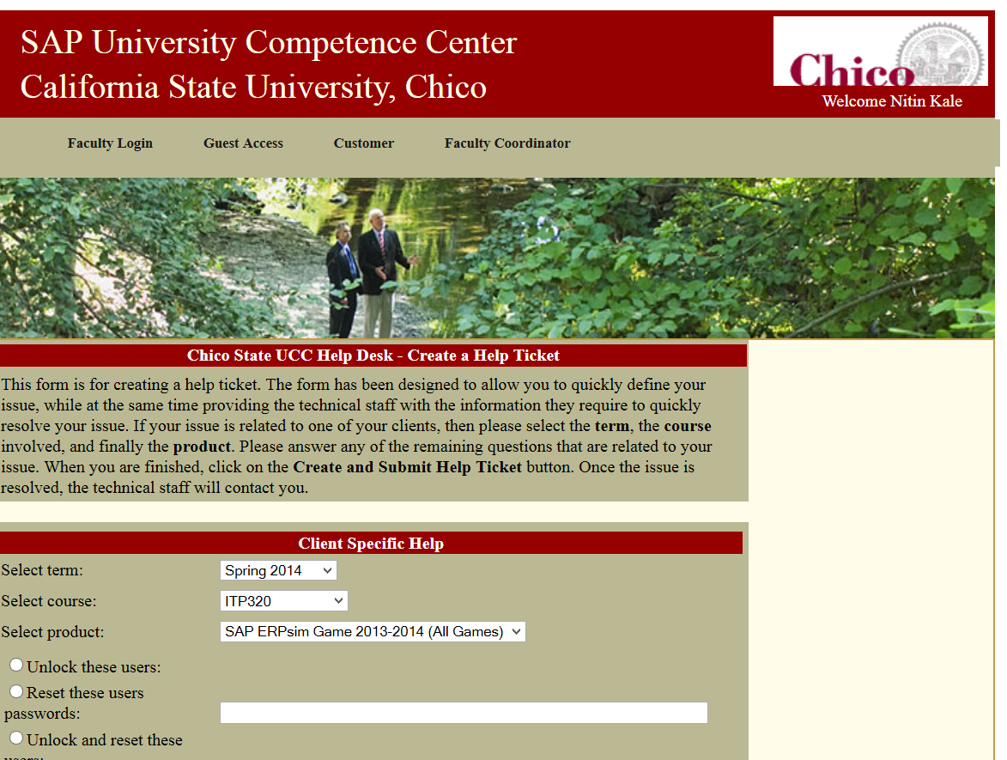
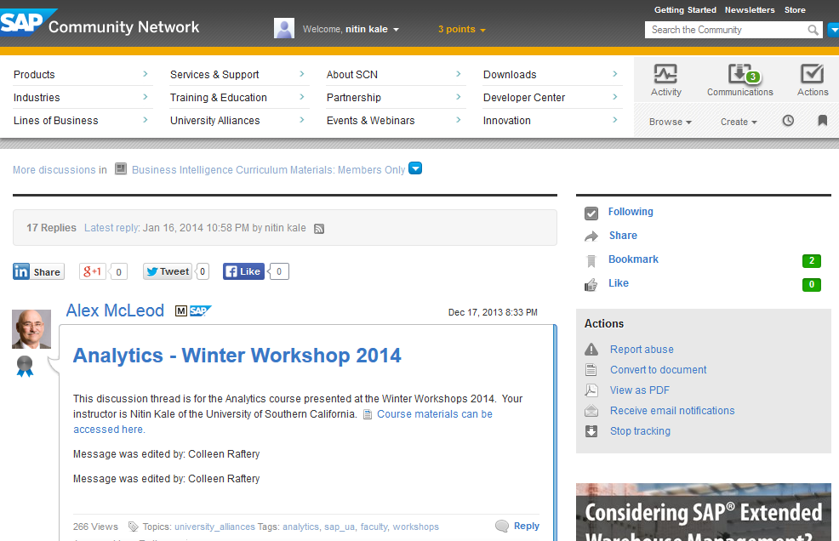
How to get support?
For system related issues, go to your UCC’s website and create a help ticket
For curriculum or academic questions about exercises, post your question on the discussion thread for the curriculum on UAC.

Slide 34
Curriculum Approach
Global Bike Inc.
Simple structure & clean data
Introductory exercises and cases
University of Arkansas Large Datasets (http://walton.uark.edu/enterprise/)
Dillard’s Department Stores, Sam’s Club, Tyson
Millions of records
Complex cases and investigation

Slide 35
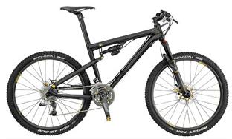
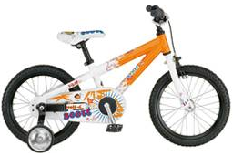
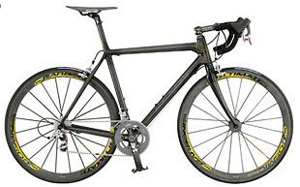
Global Bike Inc.
Company in the bicycle business
Manufacturer of touring and off-road bikes
Sells to both wholesale and Internet – procure, produce and distribute

Slide 36
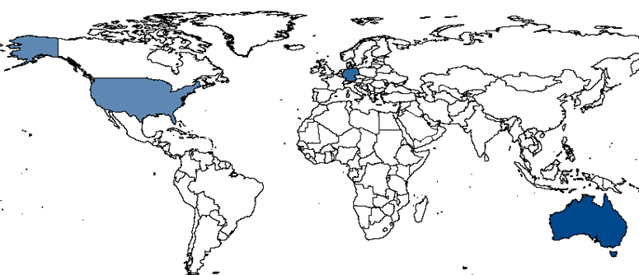
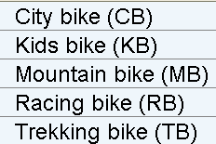
Global Bike Inc.
Sales organizations in Australia, Germany and United States
Product groups:

Slide 37
Business Case
Monitoring sales activities
Typical questions:
Which country generated the most revenue?
Which customers generated the most revenue?
Which were the most successful product groups / products?
What discounts were given?
Which sales organization made the most profit?
What were the revenues compared to last year?

Slide 38
Analytic Applications
Right information to the Right users at the Right time
Analytics vs. Predictive Analytics
Variety of Data Sources
Data warehouses
ERP systems (direct access)
Whatever is necessary …..
Current catalysts for change
Mobile applications
Big data and near-real time analysis
Cloud

Slide 39
Links to Useful Material
SAP Learning Hub
https://go.sap.com/cmp/oth/sap-university-alliances/index.html (to register)
http://go.sap.com/training-certification/university-alliances.learning-center.html
SAP University Alliances Learning Room
https://jam2.sapjam.com/groups/about_page/11mofEXLDOzgNyv1RrCf4C
SAP University Alliances North America Faculty Summer Workshop, June 20 - 23, 2016, University of Wisconsin-Milwaukee
https://jam2.sapjam.com/wiki/show/TJwf8Mg4HmZUHYAuzhKUok?_lightbox=true
SAP Analytics space http://scn.sap.com/community/business-intelligence
UA Analytics Curriculum https://jam2.sapjam.com/wiki/show/ZHUSiGuWIlZKT8drWGBpA0?_lightbox=true

Slide 40
More Resources – Data Sets you can use in your class
http://archive.ics.uci.edu/ml/ UC Irvine Machine Learning Repository
http://scn.sap.com/docs/DOC-31433 Data Samples for SAP Lumira
http://www.rdatamining.com/resources/data RDataMining Free datasets
http://ibmhadoop.challengepost.com/details/data IBM's big data sets for social good
http://www.datacatalogs.org/ has a metasearch for data repositories
https://www.kaggle.com/ lots of data from competitions

Slide 41


Approach for Hands-On Case Studies/Exercises & Material
Try to get the main idea, focusing on the forest rather than the trees
No “death march” to finish each exercise
Significantly more exercises in the package
than time allows
Some material/slides will not be covered but useful when teaching
an analytics course

Slide 42
Data Warehousing and Analytics

Slide 43
MULTIDIMENSIONAL DATA MODEL
Slides by Nitin Kale

Slide 44
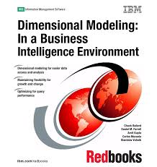
Source Reference
Dimensional Modeling: In a Business Intelligence Environment
Chuck Ballard, Daniel M. Farrell, Amit Gupta, Carlos Mazuela, Stanislav Vohnik
2006, IBM Redbooks

Slide 45
Outline
OLTP vs. OLAP
Multidimensional model
Star Schema
Dimension Tables
Fact Table
Multidimensional Analysis
SAP BW Datawarehouse

Slide 46
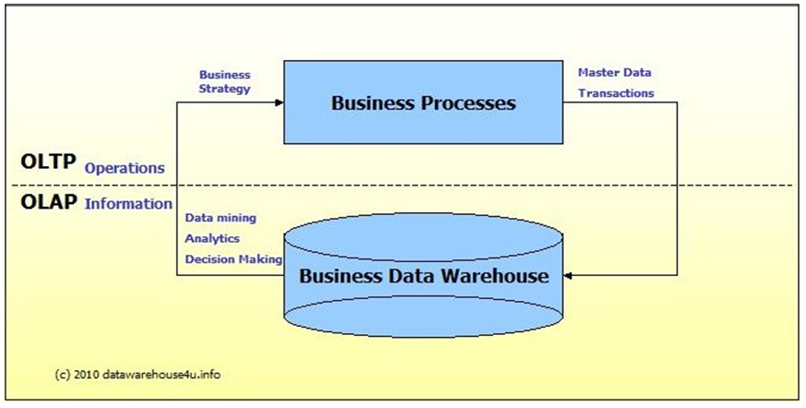
OLTP vs. OLAP Systems
Source: Datawarehouse4u.Info. OLTP vs. OLAP. Retrieved from http://datawarehouse4u.info/OLTP-vs-OLAP.html

Slide 47
OLTP vs. OLAP Data Models
OLTP data models built to enhance transaction speed
Highly normalized – low redundancy
OLAP data models built to enhance dimensional analysis speed
Not normalized – high redundancy (star schema)
Organized based on analysis business logic
Star schema is the basic design

Slide 48
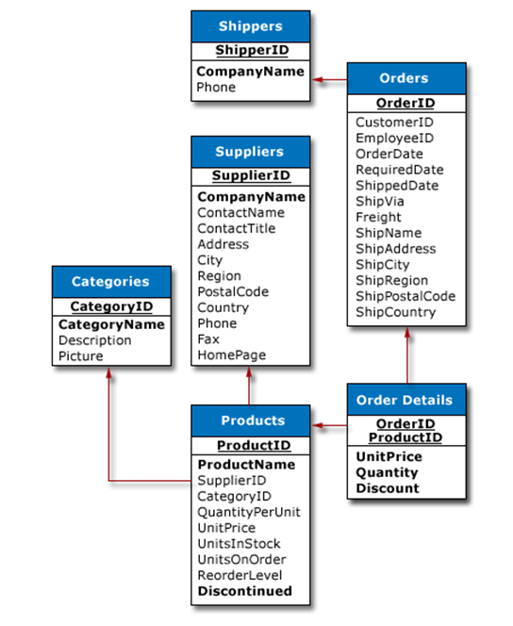
OLTP Example (Partial)
Source: Mailvaganam, H. (2007). Introduction to OLAP. Data Warehousing Review. Retrieved from http://www.dwreview.com/OLAP/Introduction_OLAP.html - Introduction to OLAP

Slide 49
Star Schema
Multidimensional data models are needed for the creation of data warehouses
The classic star schema is a commonly used multi-dimensional model
This database schema classifies two groups of data: facts (sales or quantity, for example) and dimension attributes (customer, material, time, for example).
Facts are the focus of the analysis of a business' activities. The fact data (values for the facts) are stored in a highly normalized fact table.

Slide 50
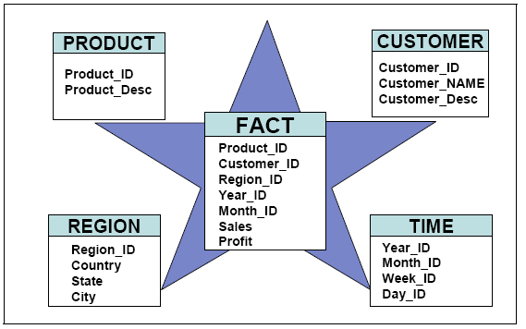
Star Schema

Slide 51
Star Schema contd.
The values of the dimension attributes are stored in various denormalized dimension tables
The dimension tables are linked relationally with the central fact table by way of foreign / primary key relationships.
The dimensional attribute with the finest level of detail of the corresponding dimension table is a foreign key in the fact table.
In this way, all data records in the fact table can be identified uniquely.

Slide 52
Classic Star Schema
Store Dimension
Fact Table
Time Dimension
STORE KEY
STORE KEY
PERIOD KEY
Store Description
City
State
District ID
District Desc.
Region_ID
Region Desc.
Regional Mgr.
PRODUCT KEY
PERIOD KEY
Period Desc
Year
Quarter
Month
Day
Dollars
Units
Price
Product Dimension
PRODUCT KEY
Product Desc.
Brand
Color
Size
Manufacturer

Slide 53
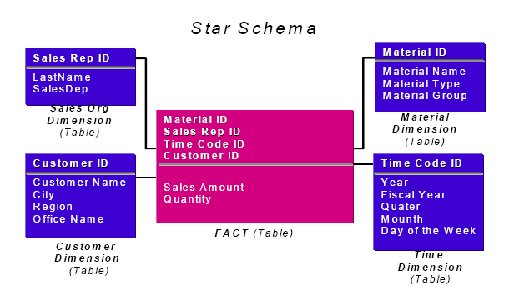
Another example

Slide 54
Dimension Tables
The dimension tables in the classic star schema are often referred to as dimensions. A dimension (perspective) describes a possible user's (decision-maker's) view of the facts.
Each classic star schema consists of one or more dimension tables. Each dimension table has a primary key, called the dimension key. This key is determined by the dimension attribute with the highest level of detail. Sales example: The dimension attribute 'DAY' (DAY _ID) is the primary key in the time dimension table.
The dimension tables are linked relationally with the central fact table by way of foreign / primary key relationships.
The dimension tables are denormalized.

Slide 55
CUSTOMER DIMENSION TABLE
Customer_ID | Cust_Name | City | Regio
K100 | Jorgensen | Oslo | North
K200 | Fourier | Paris | West
MATERIAL DIMENSION TABLE
Material_ID | Material_Name | Material_Group
M100 | Jorgensen | Oslo
M200 | Fourier | Paris
TIME DIMENSION TABLE
Day_ID | Month | Quarter | Year
03.01.2008 | 01.2008 | Q1 | 2008
05.08.2008 | 08.2008 | Q3 | 2008

Slide 56
Fact Table
Day_ID | Customer_ID | Material_ID | Sales | Quantity
03.01.2007 | K100 | M1111 | 50 | 100
03.01.2007 | K100 | M2222 | 30 | 120
03.01.2007 | K200 | M100 | 33 | 2
03.01.2007 | K200 | M200 | 100 | 50
05.01.2007 | K200 | M222 | 200 | 300
… | … | … | … | …
Primary Key of fact table
Facts

Slide 57
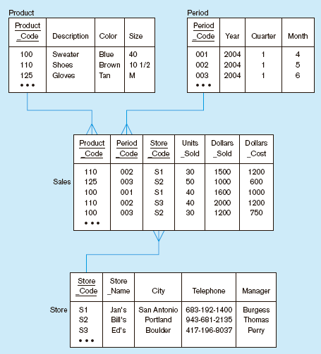

Slide 58
Fact Table features
Each classic star schema is made up of one fact table.
Facts are numeric values of a normally additive in nature.
Total sales, total quantity
Fact table is connected relationally with the surrounding dimension tables via a unique key.
The primary key of the fact table is made up of all dimension keys (=foreign keys).
The fact table is highly normalized.
Fact data corresponds to transaction data.
Dimension tables correspond to ____?___ data.

Slide 59
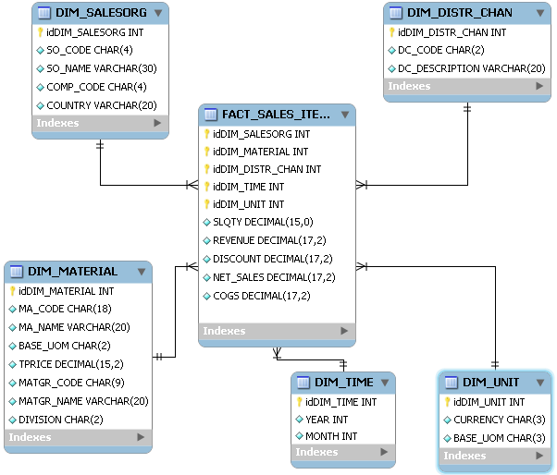
Star Schema: Tables

Slide 60
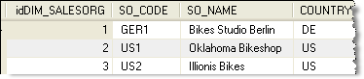
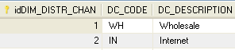
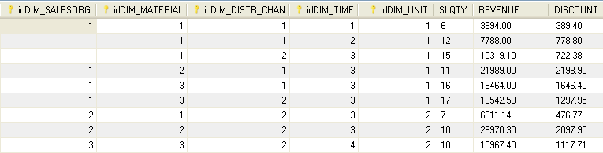
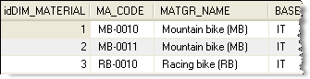
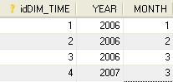
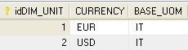
Star Schema: Table Entries
DIM_SALES_ORG
DIM_DISTR_CHAN
Fact Table FACT_SALES
Foreign Keys
DIM_PRODUCT
DIM_TIME
DIM_UNIT

Slide 61
Keys

Slide 62
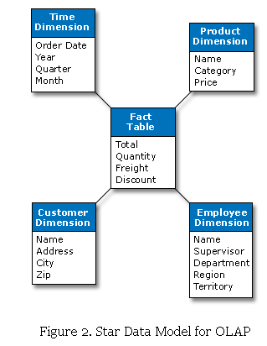
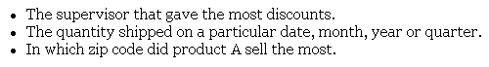
OLTP vs. OLAP Queries
Which schema would have less complicated, faster queries?
Source: Mailvaganam, H. (2007). Introduction to OLAP. Data Warehousing Review. Retrieved from http://www.dwreview.com/OLAP/Introduction_OLAP.html - Introduction to OLAP

Slide 63
Pro and Cons of Star Schema
Pros
Simplicity from the users' point of view
Queries are never complex because the only joins and conditions involve a fact table and a single level of dimension tables
Cons
Poor performance if there are huge dimension tables (100,000+ records)
Multilingual descriptions of attributes (within dimension tables) is cumbersome
No historization. i.e. If attributes of dimensions change over time, there is no way of maintaining the old and new values
Dimension tables are not normalized, leads to redundancy

Slide 64
Hierarchy
The aggregation is primarily performed by using attributes of a dimension which are a part of a hierarchy.
Attributes within dimensions can be ordered in a well-defined attribute hierarchy.
The attribute hierarchy provides a top-down data organization that is used for two main purposes
Aggregation
Drill-down/roll-up

Slide 65
Hierarchy contd.
Any number of semantically-related dimension attributes are stored in a hierarchy (parent-child relationship as a 1:N-relationship). Eg. the time dimension tables are made up of the dimension attributes 'Year', 'Quarter', 'Month' and 'Day'. Year has many quarters, quarters have months, months have days
LOCATION attribute may have a hierarchy Region → State → City → Store

Slide 66
Aggregation
Aggregates provide a restricted list of the key columns of a fact table and an aggregation - generally a SUM() - of some or all of the numeric facts.
Aggregation is the process of calculating summary data from detail base level fact table records.
Aggregates are a powerful tool for increasing query processing speed in dimensional data marts.
The aggregation is primarily performed by using attributes of a dimension which are a part of a hierarchy.

Slide 67
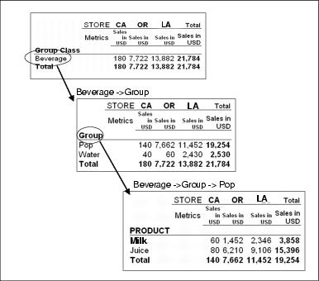
Drill down

Slide 68
Multidimensional Analysis
Common multidimensional techniques
Slice and dice
Pivoting
Drill-down, drill-up, and drill-across
Roll-down and roll-up

Slide 69
Data Cube
The multidimensional data model is represented by a cube. (not limited to 3D)
Data from the star schema is visualized as a cube, however, this cube is only a conceptual representation of multidimensional data

Slide 70
Cube
Product Dimension
Customer Dimension
Sales Dimension
Quantities Revenues Costs Taxes
Product Dimension
Time
Time Dimension
Competition Dimension
Customer Dimension
Star Schema (Logical)
Cube (Physical)

Slide 71
Q1
Q2
Q3
Time Dimension
Q4
Grapes
Cherries
2002
Melons
Products Dimension
Apples
Ave
Units
Sales
Units
Net
Price
Sales
Dollars
Measures Dimension

Slide 72
Drill Down, Slice and Dice
Customer
group
Region
North South East
Dept. Stores
Wholesale
Retail
Glass- Ceramics Plastics Pottery Copper Pewter
ware
Division

Slide 73
Drill Down, Slice and Dice

Slide 74
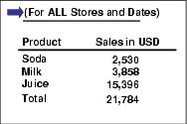
Slice
Slice is used to define a member or a group of members that are separated (from ALL other dimensions) and then evaluated across all other dimensions.
This slice of a product dimension lets us to select our concerned members (soda, milk, and juice) from the product dimension. The slicing of the members allows us to focus only on these three members across all other dimensions.

Slide 75
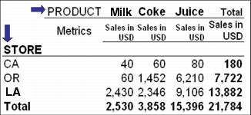
Dice
Dicing means that you put multiple members from a dimension on an axis and then put multiple members from a different dimension on another axis.

Slide 76
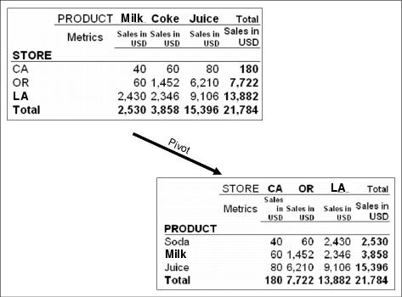
Pivoting
Pivoting means exchanging rows with columns and vice versa.

Slide 77
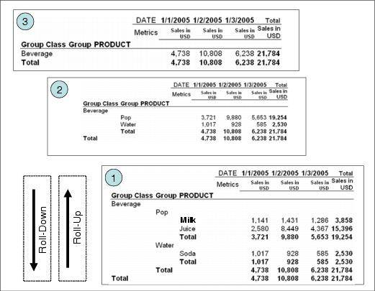
Drill Down/Drill up
Drilling means going from one hierarchy level to another. Also known as rolldown - rollup

Slide 78

Drill across
Drill-across is a method where you drill from one dimension to another. You must define the drill-across path.

Slide 79
SAP Business Information Warehouse (SAP BW) Modeling

Slide 80

Dimensional Models

Slide 81
Star Schema Limitations
No support for multiple languages
Reduced performance due to the use of Alphanumeric keys
No support for time dependent changes (historization)
Duplication of Dimensional data
Modeling some hierarchies can lead to anomalies
Fact Table
Date ID
Year
Fiscal Year
Quarter
Month
Material ID
Customer ID
Date ID
Sales Amount (K)
Unit Price (K)
Quantity (K)
Customer ID
Customer Name
City
Region
Type
Time
Dimension
Material ID
Material Name
Material Type
Material Group
Customer
Dimension
Material
Dimension

Slide 82
Snowflake model
SAP BW uses a snowflake model instead of the star schema
Further normalization and expansion of the dimension tables in a star schema results in a snowflake design.
This reduces data redundancy which reduces storage space but increases the number of joins.
A dimension is said to be snowflaked when the low-cardinality (it has very few unique values) columns in the dimension have been removed to separate normalized tables that then link back into the original dimension table.

Slide 83

Snowflake

Slide 84

Snowflake example

Slide 85
When do you snowflake?
Snowflaking a dimension table can typically be performed under the following two conditions:
The dimension table consists of two or more sets of attributes which define information at different grains (detail)
The sets of attributes of the same dimension table are being populated by different source systems (very common in data warehouses)

Slide 86
InfoCubes
InfoCubes are the central objects of the multi-dimensional model in SAP BW
Reports and analyses are based on these InfoCubes
It is a self-enclosed dataset for a business area from a reporting viewpoint
Queries can be defined and executed on the basis of an InfoCube

Slide 87
SAP BW– InfoCube
Contains two types of data
Key Figures (transactional data)
Characteristics
1 Fact Table and 16 Dimension Tables
3 Dimensions are predefined by SAP
Time
Unit
Data Package
Dim1 | Dim2 | Dim3 | Dim4 | Dim5 | Dim6 | KF1 | KF2
3 Pre-defined
Up to 13 User-defined

Slide 88

InfoCube and Master Data

Slide 89
Terms used
Classic Star Schema | SAP BW Schema
Fact | Key Figure
Fact Table | Fact Table
Dimension Table | Dimension
 | Master Data Tables – Text, Attributes, Hierarchy
Dimension Attribute | Characteristic

Slide 90
BW Icons
 | Key Figure
 | Characteristic
 | InfoCube
 | Dimension
 | Hierarchies
 | Maintain Master Data
 | Text
 | InfoObject
 | InfoSource
 | Source System
 | InfoArea

Slide 91
SAP BW InfoObjects
InfoObjects
Represent the structure that allows data to be stored in a BW system.
Used to describe business processes and information requirements (fields):
Customers
Sales revenue
Either Characteristics or Key Figures.

Slide 92

InfoObjects Are “Bricks” for Data Structures

Slide 93
InfoObjects
Fields in data source mapped to InfoObject definitions with transformations
Types of InfoObjects:
Key figures: Numeric measures
Characteristics: Master data (customer, product, etc.) with optional descriptive texts, attributes and hierarchies
Units: Units of measure for key figures

Slide 94

InfoObject Definitions
Standardized “single version of the truth”
Reusable building blocks for data stores
Example Data Store

Slide 95
SAP BW InfoObjects – Key Figures
Key Figures
Any kind of numeric information used to measure a business process.
Six different types
Amount *
Quantity *
Number
Integer
Date
Time
* Requires Unit (currency, size) for further clarification
Date | Customer | Material | Sales Quantity | Amount
1/1/08 | Jones | Racer 26 | 2 | $2000
1/1/08 | Rosemann | Mountain B | 5 | $4000
Amount | Currency
1000 | EUR
1500 | USD
30,000 | ZWD

Slide 96
SAP BW InfoObjects – Characteristics
Characteristics
Designed to describe objects used with in the business process
customer, product, colour, postcode, date, unit etc.
They are the attributes of the dimension table
Could be made up of more than one field
Used to analyze Key Figures

Slide 97
SAP BW Characteristics
Characteristic
(Single)
Region
City
Customer Name
Customer Phone
Characteristic
(Grouped)
Customer
State
City
Customer Name
Customer Phone
(Attributes of Customer)

Slide 98
SAP BW – Characteristics
Characteristic
definition contains:
Technical field descriptions (data type, length, etc)
Display properties
Transfer routines (executed when data is uploaded)
Master data descriptions (time dependency, navigational properties, text properties, language dependency, Hierarchies)
Unit Characteristic
currencies and units of measure are required for Amount and Quantity data types
Time Characteristic
Mandatory assignment to time dimension in InfoCube, (Calendar year)
Technical Characteristic
only technical use in BW (Request ID)

Slide 99

SAP BW– InfoArea/InfoCatalog
An InfoArea is a directory that stores all related InfoObjects within the same business context.
An InfoObject Catalog is a folder within an InfoArea that stores specific InfoObjects.
Separate InfoObject Catalogs are used for Key Figures and Characteristics
Displayed via a tree structure or directory

Slide 100
InfoProviders
InfoProviders:
Are data storage meta objects inside SAP BW
May store data records physically (persistent)
May also be used to access data stored outside SAP BW virtually (transparent views)
May be accessed with front end tools such as SAP BusinessExplorer (BEx)

Slide 101

Global Bike Reporting Star Schema

Slide 102

Global Bike InfoCube Display
1. Dimension
3. Navigation Attributes selected for use in analysis.
2. Characteristic

Slide 103


Navigation Attributes Displayed as if Dimensional Characteristics in Query Designer

Slide 104
Summary
SAP BW uses an enhanced (snowflake) star schema
Dimension tables, fact table and master data tables are used to create the snowflake
Master data tables reside outside the InfoCube
InfoObjects are the smallest “bricks” to define InfoProviders within SAP BW.
Characteristics and key figure InfoObjects are used to model attributes of dimension tables and fact tables respectively
Key Figures and Characteristics are defined as InfoObjects.
InfoProviders are used to store data within SAP BW or allow SAP BW to access data stored somewhere else..

Slide 105
Workshop Login Info
University of Arkansas
Teradata 130.184.26.161
WBI-SAP BW (University of Arkansas) (sapprt.walton.uark.edu) / client 200
UWM BW
BI6 (bi6.ucc.uwm.edu)/ client 800
Data files for this workshop are at: https://jam2.sapjam.com/groups/11mofEXLDOzgNyv1RrCf4C/content?folder_id=5L7dMr7mk61BlzPyaCmLSc

Slide 106
Hands On Exercises
03- Big Data Analysis using GBI Sales Monitor with SAP ERP on HANA

Slide 107
Introduction to SAP BusinessObjects Analysis
Overview of Analysis

Slide 108
SAP Analytics Tools Overview
Query Designer
MS-Office
SAP
SAP Crystal
Web Intelligence
Analysis
Design Studio
Predictive Analytics
Crystal Reports
Crystal Dashboard Design
Cloud
Analytics Applications
SAP BusinessObjects
Business Explorer (BEx)
Visual Business
Lumira
Data sources and Data Staging
Business Warehouse : SAP Netweaver BW
High-Performance In-Memory Appliance SAP HANA
Business Suite
Non-SAP

Slide 109
SAP BusinessObjects Analysis
Analysis is a powerful, in-depth, OLAP analysis tool that provides
Capability to create predefined workbooks that included guided navigation
Ad Hoc OLAP analysis
Hierarchical awareness
Data visualization
Best suited for power users such as a business analysts
Recommended successor to SAP Business Explorer Analyzer (BEx Analyzer)

Slide 110

SAP BusinessObjects Analysis & Design Studio The premium alternative to BEx

Slide 111
SAP BusinessObjects Analysis family
SAP BusinessObjects Design Studio
Studio for building apps
SAP BusinessObjects Analysis, edition for Microsoft Office
Excel based OLAP analysis
Live PowerPoint presentations
SAP BusinessObjects Analysis, edition for OLAP
Web-based OLAP

Slide 112

SAP BusinessObjects Analysis, edition for Microsoft Office
This edition is an excellent alternative to BEx Analyzer with enhanced functionality

Slide 113
What is SAP BusinessObjects Analysis, edition for Microsoft Office
A Microsoft Office Add-In that allows multidimensional analysis of OLAP sources, MS Excel workbook application design and creation of BI presentations with PowerPoint
BEx Queries, BEx Query views, BW InfoProviders can be used as data sources
The data is displayed in the workbook in crosstabs
Design panel is like the Excel Pivot Table feature using “drag and drop” functionality
Advanced functionality includes API functions to use with Visual Basic Editor
Must be installed on your local machine

Slide 114
Prerequisites
Front end - Client-side
Windows XP or higher
BEx Query Designer: a desktop tool for defining queries on SAP NetWeaver BW data
Analysis Add-In for Microsoft Excel
Microsoft Office 2003, MS Office 2007 or higher (32 bit and 64 bit installer)
Analysis Add-In for Microsoft PowerPoint
MS Office 2007 or higher
BusinessObjects/BI Platform is optional

Slide 115

Data Connectivity Options
We will use this connection for the exercises
Source: SAP

Slide 116
SAP BusinessObjects Analysis can connect to… Why we are using a BEx query
With BEx Query
BEx Query Views
InfoCubes
Without BEx Query (direct to InfoProvider)
InfoCubes
Multiproviders
Remote Cubes
Virtual InfoCubes
Data Store Objects (DSO)
BW InfoSets
Classic InfoSets (Transient Provider)
MultiProviders
DSO
BW InfoSets

Slide 117
Analysis Functionality
Analyze the data and change the view on the displayed data.
Add and remove dimensions and measures to be displayed easily with drag and drop.
Refine analysis using
Conditional formatting
Filter
Prompting
Calculations
Display hierarchies.
Add charts
Currency conversion
Convert to PowerPoint.

Slide 118
Microsoft Office Edition Features
Design/Task/Navigation Panel like Excel “Pivot” table
Drag and Drop (BEx Analyzer had this too…but)
Undo button
PowerPoint Integration
From Excel to PowerPoint, or a new analysis within PowerPoint
Easy insertion of multiple data sources
Pause/Refresh button
Runs any BW Query
Add multiple queries to one workbook

Slide 119
Terminology
Data Source = BW Query or InfoProvider
Dimension = Characteristic e.g. customer
Crosstab = The rows and columns output that appears in Excel. An Excel workbook can contain several Analysis crosstabs.
Design Panel = main panel where the output of the query is controlled
Analysis Ribbon = In Excel 2007/2010/2013, a separate ribbon (menu) appears in Excel with various buttons and menus
Context Menu = Popup menu that appears when right-clicking a field in the output of Analysis

Slide 120

User Interface in Excel
Characteristics/Dimensions
Key Figures/Measures
Analysis Ribbon
Design Panel
Available Data Source Fields
Columns
Rows
Background Filter

Slide 121

PowerPoint vs. Excel Analysis Ribbons
PowerPoint Ribbon
Excel Ribbon

Slide 122

Exporting to PowerPoint
Can export analysis from Excel to PowerPoint or
Insert BEx query results directly

Slide 123

Design Panel
Three Views
Analysis
Navigation - Drag and drop dimensions into rows or columns (or remove)
Filter a dimension by specific member
Slicing and dicing
Information
General information on data source/workbook
Information on filters, variables in one place
Components
Structure information view from data source / worksheet perspective
Navigation
Drag and drop
Hierarchies
Display attributes (from BW InfoObjects)

Slide 124

Features
Define conditional formatting (aka “exceptions”)
Define filter by measure (aka “conditions”)
Define easy calculations and dynamic calculations
Excel comments on data cells
Collapse into hierarchical structures (“display hierarchy”)
Show/hide hierarchy levels
Sort break hierarchies
Pause refresh -Design of several steps with only one final roundtrip to the server to fetch the data

Slide 125

Features (continued)
Planning
Support of BW-integrated planning

Slide 126
BW Query Elements in Analysis for Office
SAP NetWeaver BW Query element | Analysis, Edition for Microsoft Office
Characteristic | Separate fields for key and description per characteristic.
Hierarchy | Each available hierarchy is shown
Key figure | Each Key figure is shown as a measure object (no separate fields for Unit)
Calculated Key figure & Restricted Key figure | Treated like a key figure; user does not have access to underlying definition
Filter | Filters will be shown in the navigation panel
Navigational attribute | Treated like a characteristic
Display attribute | Each Display Attribute is shown as subordinate for the characteristic
Variables | Turned into prompts
Structure | Structures are shown in the navigation panel and structure elements can be filtered / selected
Exceptions | Are turned into “read only” conditional formatting
Conditions | Are turned into “read only” Filter by Measure
Display settings | Fully supported, for example scaling, rounding, …

Slide 127
Summary
Analysis for Office is the successor to BEx Analyzer
Analysis provides powerful multidimensional analysis capabilities
Excel Pivot table skills are a good starting point to using Analysis, Edition for Microsoft Office
Slicing, dicing, pivoting, sorting, filtering, charting, and highlighting are some of the important features of Analysis

Slide 128
Resources
SAP Space for Analysis: http://scn.sap.com/community/businessobjects-analysis-ms-office
User Guide for Analysis http://help.sap.com/businessobject/product_guides/AMS13/en/13_aaoffice_user_sp3_en.pdf
Book http://www.sap-press.com/products/Inside-SAP-BusinessObjects-Advanced-Analysis.html#
Tutorials - http://scn.sap.com/docs/DOC-7679
Blog – Many by Tammy Powlas, Fairfax County Water Authority
http://scn.sap.com/community/businessobjects-analysis-ms-office/content?filterID=content~objecttype~objecttype[blogpost]

Slide 129
BusinessObjects Analysis Exercises
Exercise 1 requires:
BusinessObjects Analysis 2.2
Download from your UCC
MS Excel and MS PowerPoint
Access to the SAP BW
Request this client and the infoarea from your UCC
Exercise 2 and 3 require access to the UArk data sets
Tyson Foods and Sam’s Club

Slide 130
Hands-On Exercises – 04 - BusinessObjects Analysis

Slide 131
In Memory & Distributed Databases

Slide 132

Learn more on OpenSAP: https://open.sap.com/courses/big1

Slide 133
In Memory Databases
HANA
“Only SAP HANA takes full advantage of all-new hardware technologies by combining columnar data storage, massively parallel processing (MPP), and in-memory computing by using optimized software design.”
For analytics stores; e.g. data marts
Replace relational databases
Secondary database for accelerated processing of existing applications
SAP HANA optimizes memory access between the CPU cache and main memory

Slide 134

SAP HANA

Slide 135


Slide 136

In Memory Databases
HANA

Slide 137

See http://sapvod.edgesuite.net/TechEd/TechEd_Berlin2014/pdfs/DMM201.pdf

Slide 138

MapReduce Exercise using Cards
In class exercise created by Michael Bliemel, Dalhousie University

Slide 139


Popular open source application of MapReduce
“The Apache™ Hadoop® project develops open-source software for reliable, scalable, distributed computing” (https://hadoop.apache.org/ )
Open source framework for storing and analyzing massive amounts of distributed, unstructured data
Originally created by Doug Cutting at Yahoo!
Hadoop clusters run on inexpensive commodity hardware so projects can scale-out inexpensively
Increasing popularity and adoption
Source: Sharda et al. 2014

Slide 140

Distributed Databases
Hadoop
“High speed”
Distributed processing
Parallel processing
Open-source
Hadoop Common: The common utilities that support the other Hadoop modules.
Hadoop Distributed File System (HDFS™): A distributed file system that provides high-throughput access to application data.
Hadoop YARN: A framework for job scheduling and cluster resource management.
Hadoop MapReduce: A YARN-based system for parallel processing of large data sets.

Slide 141

In this exercise the class will be the Compute Cluster The Cards will be the Data

Slide 142

Data Meaning
The multiple decks of cards represent raw data. Some of which is useful.
For example these could represent product reviews on webpages – where the number is the stars rating, the suit is the product, and the other cards A, J, K, Q, Jokers are text on the page that is not useful

Slide 143

Problem 1
Randomly remove 10-20 cards from the pile
What product has the best reviews? Hearts, Spades, Clubs or Diamonds?
You need to sum all the points of all the cards of each suit
Add these

Slide 144

The Hadoop Distributed File System
One student is the Job Tracker
Each student at the end of a row is a Task Tracker
The rest of the class are worker nodes that will do the data processing

Slide 145
Job Tracker
The job tracker will fairly distribute the work (cards) to each task tracker (student at the end of the row) nodes in the cluster (the class)
The task tracker then distributes the data to the worker nodes in their row so that the workload is evenly balanced (the task tracker can also do work in this instance, but some HDFS implementations have trackers only tracking.)

Slide 146

Map
Each worker node now maps the data – by Product and Review
Sort the cards into piles by suit and discard the non number cards
2,3,4,5,6,
7,8,9,10

Slide 147
Reduce
Now the Task tracker moves cards from nodes to recombine into suits so that each worker node has one or two suits, and all cards of that suit
Worker nodes now sum up the total points and report them to the Task Tracker
The Job Tracker asks each Task Tracker for their totals and then determines which products (suit) ranks highest

Slide 148

Part 2: Timed Challenge
Reshuffle all the cards
Pick one card, do not reveal it to the class
Give the data (cards) to the Job Tracker
The Hadoop Cluster now has the job to find the missing card
The Job Tracker delegates the work to Task Trackers
Remember to balance the work between task tracker nodes
Be specific with the job – i.e. Sort these by suit, then by number
You can move data across Task Nodes

Slide 149
Day 2

Slide 150
Agenda for Tuesday June 21, 2016
Start | End | Topic | Description
9:00 | 10:30 | Multidimensional analysis: SAP BusinessObjects Analysis, Edition for Microsoft Office | Hands on Exercises in BusinessObjects Analysis
10:30 | 10:45 | Break
10:45 | 12:00 | Multidimensional analysis: SAP BusinessObjects Analysis, Edition for Microsoft Office | Hands on with Uark Dataset Sams Club & Tyson Foods
12:00 | 13:00 | Lunch break
13:00 | 14:30 | Data manipulation and visualizations with Lumira (Predictive Analytics) | Hands on exercises on Lumira
14:30 | 14:45 | Break
14:45 | 15:30 | Data manipulation and visualizations with Lumira (Predictive Analytics) | Hands on exercises on Lumira cont.
15:30 | 16:00 | Predictive Analytics Overview | General Introduction on Predictive Analytics
16:00 | 17:00 | University Alliance Meeting

Slide 151
SAP LUMIRA

Slide 152
SAP Analytics Tools Overview
Also part of Predictive Analytics
SAP
SAP Crystal
Web Intelligence
Analysis
Design Studio
Predictive Analytics
Crystal Reports
Crystal Dashboard Design
Cloud
Lumira
Analytics Applications
SAP BusinessObjects
Business Explorer (BEx)
Visual Business
Data sources and Data Staging
Business Warehouse : SAP Netweaver BW
High-Performance In-Memory Appliance SAP HANA
Business Suite
Non-SAP

Slide 153


Slide 154


Slide 155


Slide 156


Slide 157


Slide 158


Slide 159

SAP Lumira

Slide 160


Slide 161


Slide 162
Resources
SAP Analytics space http://scn.sap.com/community/business-intelligence
Tutorials http://www.sdn.sap.com/irj/boc/bi-suite-tutorials
SAP Lumira Tutorials http://scn.sap.com/docs/DOC-26507
Book http://www.sap-press.com/products/Integrating-SAP-BusinessObjects-BI-Platform-4.x-with-SAP-NetWeaver.html

Slide 163
Hands-On Exercises – 05 – Visualization with Lumira 06 – Accounting with Lumira

Slide 164
SAP PREDICTIVE ANALYTICS

Slide 165
SAP Analytics Tools Overview
Automated Mode
&
Expert Mode
SAP
SAP Crystal
Web Intelligence
Analysis
Design Studio
Predictive Analytics
Crystal Reports
Crystal Dashboard Design
Cloud
Lumira
Analytics Applications
SAP BusinessObjects
Business Explorer (BEx)
Visual Business
Data sources and Data Staging
Business Warehouse : SAP Netweaver BW
High-Performance In-Memory Appliance SAP HANA
Business Suite
Non-SAP

Slide 166
Definition of Predictive Analysis (PA)
Quantitative analysis that supports the making of predictions
Area of statistical analysis in which you extract information from data to predict patterns and trends (Wikipedia)
The process of discovering meaningful new correlations, patterns and trends by sifting through large amounts of data stored in repositories, using pattern recognition technologies as well as statistical and mathematical techniques (Gartner)
Referred to as data mining and knowledge discovery

Slide 167

Three step process – in theory…

Slide 168


Slide 169


Slide 170


Slide 171

Introduction to Next Generation Business Intelligence with Automated Analytics Mode in SAP Predictive Analytics How does Predictive Analytics fit in with other existing SAP Advanced Analytics Solutions?
Next Generation Predictive Analytics
(Automated Mode in SAP Predictive Analytics)

Slide 172

SAP Infinite Insight becomes SAP Predictive Analytics

Slide 173


Slide 174


Slide 175


Slide 176


Slide 177

Introduction to Next Generation Business Intelligence with Automated Analytics Mode in SAP Predictive Analytics How does Predictive Analytics fit in with other existing SAP Advanced Analytics Solutions?
Tools for Prediction and Data Modelling
(Expert Mode in SAP Predictive Analytics)

Slide 178

SAP PA becomes Expert Analytics in SAP Predictive Analytics

Slide 179


Slide 180


Slide 181
SAP Predictive Analytics Automated Mode
Slides used in class by Hossam Ali-Hassan & Michael Bliemel
Rowe School of Business, Dalhousie University

Slide 182



Introduction to Next Generation Business Intelligence with Automated Analytics Mode in SAP Predictive Analytics
Michael Bliemel (Dalhousie University), Kristof Schneider (SAP SE)
March 2015

Slide 183

Introduction to Next Generation Business Intelligence with Automated Analytics Mode in SAP Predictive Analytics Business Analytics in the Era of Big Data
Business Intelligence & Business Analytics
Business intelligence (BI) describes concepts and methods to improve business decision-making by using fact-based support systems” (1)
Business analytics (BA), a component of BI, “provides the data Analytics techniques used to deliver value from decision support data” (2,3)
Business intelligence and business analytics are often used interchangeably (2,3), or together as the singular term “business intelligence & analytics” (BI&A) (1)
Both terms are traditionally employed by IS researchers to denote “IT platforms and tools used to gather, provide access to, and analyse data about an organization and its activities” (4)
1. Chen, H., Chiang, R. H. L., & Storey, V. C. (January 01, 2012). Business Intelligence and Analytics: From Big Data to Big Impact. Management Information Systems Quarterly, 36, 4, 1165-1188
2. Wixom, B., Ariyachandra, T., Goul, M., Gray, P., Kulkarni, U., & Phillips-Wren, G. (2011). The current state of business intelligence in academia. Communications of the Association for Information System, 29(16), 299-312.
3. Olsen, D. H., & Dupin-Bryant, P. A. (January 23, 2013). Combining business intelligence and stock market data: A primer for data analytics and business intelligence. Journal of Applied Business Research, 29, 1, 139-156.
4.. Glaser, J., & Stone, J. (January 01, 2008). Effective use of business intelligence. Healthcare Financial Management : Journal of the Healthcare Financial Management Association, 62(2), 68-72.

Slide 184

Introduction to Next Generation Business Intelligence with Automated Analytics Mode in SAP Predictive Analytics Challenges for companies
The Advanced Analytics Market is Ripe for Disruption

Slide 185

Introduction to Next Generation Business Intelligence with Automated Analytics Mode in SAP Predictive Analytics Business Analytics in the Era of Big Data
Business Intelligence & Analytics Platforms
BI&A platforms are often composed of sets of stacked information technologies, ordered from bottom to top to include(1,2)
The architectural structure of business intelligence centers around two distinct, yet interrelated, functionalities: getting data in and getting data out (3,4)
1. Glaser, J., & Stone, J. (January 01, 2008). Effective use of business intelligence. Healthcare Financial Management : Journal of the Healthcare Financial Management Association, 62(2), 68-72.
2. Lonnqvist, A., & Pirttimaki, V. (2006). The measurement of business intelligence. Information Systems Management, 23 (1), 32-40.
3. Wixom, B., Ariyachandra, T., Goul, M., Gray, P., Kulkarni, U., & Phillips-Wren, G. (2011). The current state of business intelligence in academia. Communications of the Association for Information System, 29(16), 299-312.
4. Popovič, A., Turk, T., & Jaklič, J. (January 01, 2010). Conceptual model of business value of business intelligence systems. Management, 15, 1, 5-29.

Slide 186

Introduction to Next Generation Business Intelligence with Automated Analytics Mode in SAP Predictive Analytics Challenges for companies
Challenges keeping up with data
Seeking to avoid becoming “data rich and information poor” (1) in an era of uncertain economic times and increased global competitive pressure (2), enterprises across corporate cultures are increasingly dealing with, rather than discarding, big data by investing in advanced and uniquely tailored analytic technologies (3)
1. Popovič, A., Turk, T., & Jaklič, J. (January 01, 2010). Conceptual model of business value of business intelligence systems. Management, 15, 1, 5-29.
2. Griffin, Jane. (November 01, 2010). How Do I Make Deep Analytics Fit My Business?. Information Management 20(6).
3. Chen, H., Chiang, R. H. L., & Storey, V. C. (January 01, 2012). Business Intelligence and Analytics: From Big Data to Big Impact. Management Information Systems Quarterly, 36, 4, 1165-1188.

Slide 187
Introduction to Next Generation Business Intelligence with Automated Analytics Mode in SAP Predictive Analytics Challenges for companies
Challenges for Business Intelligence & Analytics
Effective implementation of BI&A platforms depends heavily on the professional skills of an enterprise’s workers (1,2,3)
“There is no such thing as business intelligence without the people to interpret the meaning and significance of information and to act on their knowledge gained” (1)
Employees must know what questions to ask, how to act upon the information presented, and when to communicate this information to domain experts within the organization (2,4).
1. Popovič, A., Turk, T., & Jaklič, J. (January 01, 2010). Conceptual model of business value of business intelligence systems. Management, 15, 1, 5-29.
2. Glaser, J., & Stone, J. (January 01, 2008). Effective use of business intelligence. Healthcare Financial Management : Journal of the Healthcare Financial Management Association, 62(2), 68-72.
3. Davenport, T. H. (December 01, 2013). Analytics 3.0. Harvard Business Review, 12(1).
4. Chen, H., Chiang, R. H. L., & Storey, V. C. (January 01, 2012). Business Intelligence and Analytics: From Big Data to Big Impact. Management Information Systems Quarterly, 36, 4, 1165-1188

Slide 188
Introduction to Next Generation Business Intelligence with Automated Analytics Mode in SAP Predictive Analytics Challenges for companies
Challenges for Business Intelligence & Analytics
Employees require a mix of technical and business knowledge that pairs strong information systems, and analytic software skills with occupational knowledge of the company’s business operations (2 ,3)
Critics feel that a significant constraint in exploiting the potential of BI&A is a shortage of talented employees (1,4,8)
“In the US alone a projected 1.5 million managers and analysts will lack the requisite skills to understand and make decisions based on the Analytics of vast amounts of data” (5)
1. Chen, H., Chiang, R. H. L., & Storey, V. C. (January 01, 2012). Business Intelligence and Analytics: From Big Data to Big Impact. Management Information Systems Quarterly, 36, 4, 1165-1188
2. Davenport, T. H. (2006). Competing on analytics. Harvard Business Review, 84(1), 98–107.
3. Shanks, G., Bekmamedova, N., & Willcocks, L. (July 01, 2013). Using Business Analytics for Strategic Alignment and Organisational Transformation. International Journal of Business Intelligence Research, 4 (3), 1-15.
4. Olsen, D. H., & Dupin-Bryant, P. A. (January 23, 2013). Combining business intelligence and stock market data: A primer for data analytics and business intelligence. Journal of Applied Business Research, 29, 1, 139-156.
5. Manyika, J., Chui, M., Brown, B., Bughin, J., Dobbs, R., Roxburgh, C., and Byers, A. H. 2011. “Big Data: The Next Frontier for Innovation, Competition, and Productivity,” McKinsey Global Institute

Slide 189

Introduction to Next Generation Business Intelligence with Automated Analytics Mode in SAP Predictive Analytics Opportunities and benefits for companies
The Impact of Analytics

Slide 190
Introduction to Next Generation Business Intelligence with Automated Analytics Mode in SAP Predictive Analytics Opportunities and benefits for companies
Business is paying attention to Predictive Analytics!
Competitive Advantage from Predictive Analytics
90% agree that predictive analytics has given them a competitive advantage
60% agree that predictive analytics is currently an investment priority for their organization
80% think predictive analytics will be a crucial investment within the next five years.
Rise of Big Data
95% have seen an increase in the volume of data they are dealing with over the past year.
Quick ROI
Seeing return on investment quickly, with around 30% of respondents reporting a “major positive impact” from predictive analytics within the first six months and more than 50% indicating positive impact six to nine months after roll out
Customer Facing Apps benefit most
Those using predictive analytics say it has had a positive impact on their organization with finance, sales and marketing and expect to benefit most from the use of predictive analytics in the future
Predicting customer needs and market trends are seen as the most valuable
Full story about the LoudHouse survey is here:
http://www.news-sap.com/sap-survey-finds-predictive-analytics-software-no-longer-in-the-hands-of-data-scientists/

Slide 191

Introduction to Next Generation Business Intelligence with Automated Analytics Mode in SAP Predictive Analytics Introducing Predictive Analytics
Vodafone Netherlands Helps Customers Enjoy Their Mobile Life with Predictive Analytics
https://www.youtube.com/watch?v=fEQ6DEKOAOU#t=148

Slide 192

Introduction to Next Generation Business Intelligence with Automated Analytics Mode in SAP Predictive Analytics Introducing Predictive Analytics
Business Analytics User Personas

Slide 193

Introduction to Next Generation Business Intelligence with Automated Analytics Mode in SAP Predictive Analytics Introducing Predictive Analytics
Bringing Advanced Analytics to a Wider Audience

Slide 194

Introduction to Next Generation Business Intelligence with Automated Analytics Mode in SAP Predictive Analytics Introducing Predictive Analytics
Working with real business data

Slide 195

Introduction to Next Generation Business Intelligence with Automated Analytics Mode in SAP Predictive Analytics Introducing Predictive Analytics
Analytics Task Simplification
Automated Analytics Mode

Slide 196

Introduction to Next Generation Business Intelligence with Automated Analytics Mode in SAP Predictive Analytics Introducing Predictive Analytics
Simplified Analytic Process
Faster Model Development Process with Predictive Analytics

Slide 197

Introduction to Next Generation Business Intelligence with Automated Analytics Mode in SAP Predictive Analytics How does Predictive Analytics fit in with other existing SAP Advanced Analytics Solutions?
Different Tools for different Users

Slide 198
Hands-On Exercises – 07 – Predictive Analytics Automated Mode (4 exercises) 08 – PA Automated Time Series
The following exercises will introduce you to the basics of how predictive modelling works in Predictive Analytics.

Slide 199
Day 3

Slide 200
Agenda for Wednesday June 22, 2016
Start | End | Topic | Description
9:00 | 10:30 | Predictive Analytics Automated Mode | Hands on Exercises in Predictive Analytics Auto cont.
10:30 | 10:45 | Break
10:45 | 12:00 | Predictive Analytics Automated Mode | Hands on Exercises in Predictive Analytics Auto cont.
12:00 | 13:00 | Lunch break
13:00 | 13:45 | Predictive Analytics Automated Mode | Hands on Exercises in Predictive Analytics Auto cont.
13:45 | 14:30 | Predictive Analytics Expert Mode | Hands on Exercises in Predictive Analytics Expert
14:30 | 14:45 | Break
14:45 | 17:00 | Predictive Analytics Expert Mode | Hands on Exercises in Predictive Analytics Exp cont.

Slide 201
Data Mining with SAP Predictive Analytics Expert Mode
Slides used in class by Hossam Ali-Hassan & Michael Bliemel
Rowe School of Business, Dalhousie University

Slide 202

Sources for this section
Hossam Ali Hassan and Michael Bliemel adapted materials for these teaching slides from (a) the book:
Predictive Analysis with SAP: The Comprehensive Guide,
John MacGregor
2013, SAP Press
(b) UA materials developed by Nitin Kale and Nancy Jones
and (c) Product User Guides from http://help.sap.com/pa/#section4

Slide 203


SAP Predictive Analysis (PA)
Is a statistical analysis and data mining solution that enables construction of predictive models
One integrated solution for advanced data analysis and interactive data visualizations
Identifies trends, insights and hidden patterns in the data
Provides predictions about future events

Slide 204
What is R?
R is a software environment for statistical computing and graphics
Open source programming language plus a run-time environment
Over 3,500 add-on packages; ability to write your own functions
Widely used for a variety of statistical methods: linear and non-linear models, statistical tests, time series analyses, classification and clustering, predictive, etc.
More algorithms and packages than SAS + SPSS + Statistica
Who is using it?
Growing number of data analysts in industry, government, consulting, and academia; high-tech, retail, manufacturing, CPG, financial services , banking, telecom, etc.
Why are they using it?
Free, comprehensive, and many learn it at college/university
Offers rich library of statistical and graphical packages

Slide 205

Where Predictive Analysis is used

Slide 206

The Predictive Analysis Process

Slide 207
Which Algorithm ? When?
Two Main Factors
What do you want to do? For Example Cluster the data, look for associations, predict etc.
What data you have and what are the attributes of the data
For which you then may apply a selection of algorithms and the question becomes –
Which one gives the best fit, a question in itself, as there can be several criteria, and in some cases, for example cluster analysis, best fit can be subjective measure

Slide 208
Algorithms – what to use when? 1/2
Purpose | Algorithm (when?)
Performing time-based predictions | Time Series Algorithms Single Exponential Smoothing (constant or stationary) Double Exponential Smoothing (trend) Triple Exponential Smoothing (seasonality)
Predicting continuous variables based on other variables in the dataset | Regression Algorithms Linear Regression Exponential Regression Geometric Regression Logarithmic Regression Multiple Linear Regression Polynomial Regression Logistic Regression
Finding frequent itemset patterns in large transactional datasets to generate association rules | Association Algorithms Apriori (multiple association items) AprioriLite (Single pre and post item rules only)

Slide 209
Algorithms – what to use when? 2/2
Purpose | Algorithm (When?)
Clustering observations into groups of similar item sets | Clustering Algorithms ABC Analysis (Clusters are user defined) K-Means (Desired number of clusters known) Kohonen SOMs (number of clusters unknown)
Classifying and predicting one or more discrete variables based on other variables in the dataset | Decision Trees HANA C 4.5 R-CNR Tree CHAID
Detecting outlying values in the dataset | Outlier Detection Algorithms Inter Quartile Range (global outliers) Nearest Neighbor Outlier (significant outliers) Anomaly Detection (local outliers) Variance Test (global outliers)
Forecasting, classification, and statistical pattern recognition | Neural Network Algorithms R-NNet Neural Network R-MONMLP Neural Network

Slide 210
Classes of Applications in PA
1. Time Series Analysis
2. Classification Analysis
3. Cluster Analysis
4. Association Analysis
5. Outlier Analysis

Slide 211
Classes of Applications in PA
Time Series Analysis
In this group we use past data points as the basis for projecting future ones. The data is a variable, such as sales or headcount or telemetry readings, with a series of values over time. We use historical patterns in the known data to make predictions about future values.
Classification Analysis
This is the largest group of applications of predictive analysis. In general terms we wish to predict a variable using the data of other variables that we believe affect the values of the variable that we are trying to predict. The variable that we wish to predict is variously known as the output variable, the target variable, or the dependent variable. The latter name comes from the assertion that it depends on the values of the independent variables or input variables.

Slide 212
Classes of Applications in PA
Cluster Analysis
This class of application is concerned with grouping the data into clusters or segments that have similar attributes. It is often used to subset a large data set, as we may be able to better understand the attributes of the smaller subsets. With large data sets, the relationships in the data can be harder to find and may even cancel each other out. We also cluster data so that we can focus on specific groups within a dataset.
Association Analysis
This class of applications looks for associations between things, with the best known example being the analysis of shopping baskets and the prediction that people who purchased this product are most likely to purchase these other products. In general. it is the analysis of a collection of things in some container.

Slide 213
Classes of Applications in PA
Outlier Analysis
This class of application of predictive analysis looks for the unusual and the unexpected. The outliers could be as a result of errors in the data or genuine variations in the data, which the predictive model needs to take into account. Outliers can have a significant effect on the predictions from a predictive model, so it is important to try to identify them. Outlier or anomaly detection has a major application in the area of fraud detection.

Slide 214
Association Analysis – Apriori
Analysis that looks for association between objects…duh
Apriori association analysis algorithm
Basket analysis
Output in form of rules: “if item A is purchased, then so is item B and C”
Value of rule measured by:
Rule support: number of baskets that support the rule where the combination exists, divided by the total number of baskets

Slide 215
Apriori Association Analysis
Rule confidence: how good the rule is at predicting the "right-hand side" of the rule (item B), given the "left-hand side" of the rule (item A). Number of baskets in which A and B exists, divided by the number of baskets with A in them, expressed as a percentage.
It is possible to have high support and confidence but bad rule validity
Lift: ratio of how often when A is bought is B also bought, divided by how often B is bought on its own. It measures how much better the rule is compared to just guessing the "right-hand side" of the rule. If lift >1, then B is more often bought with A; if lift <1, then B is more often bought on its own, in which case the rule is not very good.

Slide 216
Association Rule Mining Apriori Algorithm

Slide 217

Apriori Algorithm Outcome

Slide 218
Apriori Lite Association Analysis
Similar to Apriori algorithm but looks for only single item pre-rule and post-rule
More efficient, less processing time
One-to-one rules

Slide 219
Strength and Weaknesses of Association Analysis
Produces clear results
Simple calculations, easy to understand → management adoption
Cross-selling & up-selling
Exponentially more calculations as data set grows
Some results may be trivial or can’t be explained
Discounts rare items

Slide 220
Cluster Analysis
Organizing data into groups with similar characteristics
Often used as a preliminary step in predictive analysis
Undirected – no target or dependent variable
Algorithms (in increasing complexity):
ABC Classification
Top A%, next b% and final C%
Only 3 clusters
K-Means Cluster analysis
K clusters derived from data
K determined by user
The goal is to make the inter-cluster difference (distance) high and the intra-cluster difference (distance) low
Self organizing maps
m*n matrix or map

Slide 221

ABC Analysis

Slide 222

K-Means Cluster Analysis

Slide 223

K-Means Cluster Analysis

Slide 224

K-Means Cluster Analysis

Slide 225

K-Means Cluster Analysis

Slide 226

K-Means Cluster Analysis

Slide 227

K-Means Cluster Analysis

Slide 228

K-Means Cluster Analysis

Slide 229



K-Means Cluster Analysis
How to choose value of K?
SQRT(N/2), where N=number of records
Data visualization
Silhouette – cluster quality

Slide 230


Self-Organizing Maps (SOM)
Represents multi-dimensional data in much lower dimensional space (2D map)
Similar records in data set closer on output map
Number of records captured by each cell shows more populated units, indicating clusters
Number of clusters K is not pre-determined

Slide 231
Strength and Weaknesses of Cluster Analysis
Easy to understand
Not trying to predict new data – just clustering
ABC Classification
Very practical, popular
Limited to 3 groups
K-Means
Easy to understand and apply
Data driven but dependent on choice of K
Input has to be numeric
SOM
Number of clusters not predetermined but constrained to size of map
Unconstrained
Difficult to understand

Slide 232
Classification Analysis
Classify new data based on trained model
Regression Analysis
Bi-variate linear, geometric, exponential, logarithmic regression
Multiple linear, exponential regression
Polynomial regression
Logistic regression
Decision trees
CHAID
C4.5
K nearest neighbour

Slide 233

Bi-variate Linear Regression
Y = a + b * X
Y= dependent variable, outcome or output variable
X= independent or input variable
R² measure of fit (0 to 1). Closer to 1 is better.

Slide 234

Bi-variate Geometric Regression
Y = a * X^{b}
R² and F-statistic measures of fit.

Slide 235

Bi-variate Exponential Regression
Y = a * e^{bX}
R² , adjusted R² and F-statistic measures of fit
Plot and visualize.

Slide 236

Bi-variate Logarithmic Regression
Y = a + b*log(X)
R² , goodness-of-fit and F-statistic measures of fit
Plot and visualize.

Slide 237
Multiple Linear & Exponential Regression
Linear
Y = β₀ + β₁ * X₁ + β₂ * X₂ +… +β_{N} * X_{N}
N independent variables X and 1 dependent variable
R² measure of fit
Exponential
Y = β₀ * exp (β₁ * X₁ + β₂ * X₂ +… +β_{N} * X_{N} )
N independent variables X and 1 dependent variable
R² , adjusted R² and F-statistic measures of fit

Slide 238

Polynomial Regression
Y = β₀ + β₁ * X + β₂ * X² + β₃ * X³ … +β_{N} * X^{N}
N determines the degree of polynomial
R² and F-statistic measures of fit
Plot and visualize.

Slide 239

Polynomial Regression
Polynomial regression curves from 2 to 6 degrees

Slide 240
Logistic Regression
Prediction is binary (0 or 1) or categorical (yes or no)
Measures of performance:
Sensitivity=ability to identify positive results
Specifity=ability to identify negative results
Others (precision, recall, accuracy)
The higher (closer to 1) the better

Slide 241
Strength and Weaknesses of Regression Analysis
Many business applications
Simple models are easy to understand → popular
Variety for wide range of applications
Outliers can mess-up results
Overfitting
Mathematical patterns do not always translate to cause/effect

Slide 242

Classification Analysis – Decision Trees

Slide 243


Decision Trees – Data
Binning of temperature and humidity figures
Chi-square statistic (CHAID analysis) or low entropy/uncertainty (C4.5 algorithm) to test if split is significant

Slide 244

Decision Tree Visualization

Slide 245

Decision Tree Visualization in PA

Slide 246

Decision Tree – Fitting Tests

Slide 247
Strength and Weaknesses of Decision Trees
Produce rules that can be implemented
Clear and understood → popular
Handle continuous numerical and categorical variables
Clear importance of variable (initial splits, length of branch, and probability of leaf outcome)
Not computational heavy (good for large data sets with many independent variables)
Sensitive to initial split
Examine one variable at a time

Slide 248


Classification Analysis – K Nearest Neighbour
Compare each prediction point to K neighbours
User selects value of K

Slide 249
Strength and Weaknesses of KNN Algorithm
Elegant
Logical
Easy to understand
Sensitive to selected value of K
Affected by outliers

Slide 250




Time Series Analysis
Stationary time series
Time series with a trend
Time series with a seasonal and trend pattern
Time series with a seasonal pattern

Slide 251


Time Series Analysis
Single exponential smoothing
Good for stationary time series
Weighted average of the past (more recent points have a higher weight Alpha than older ones)
Caution needed when selecting Alpha, start time, & other parameters

Slide 252


Time Series Analysis
Double exponential smoothing
Good for time series with a trend
Caution needed when selecting Alpha, Beta, start time, & other parameters

Slide 253


Time Series Analysis
Triple exponential smoothing
Good for time series with seasonality
Caution needed when selecting Alpha, Beta, Gamma, start time, & other parameters

Slide 254
Strength and Weaknesses of Time Series
Many business applications
Easy to understand – good for management
Computational efficiency – good for large data volume
Sensitive to outliers
Affected by starting assumptions
Requires substantial historical data
Bad for spikes or event-based time series

Slide 255
Hands On Exercises
09 - Predictive Analytics Expert Analysis – Association
10 - Predictive Analytics Expert Analysis – Segmentation
11 - Predictive Analytics Expert Analysis with Teradata
12 - Predictive Analytics Expert Analysis – Time Series
13 - Predictive Analytics Expert Analysis with R

Slide 256
Day 4

Slide 257
Agenda for Thursday June 23, 2016
Start | End | Topic | Description
9:00 | 10:30 | Predictive Analytics Expert Mode | Hands on Exercises in Predictive Analytics Exp cont.
10:30 | 10:45 | Break
10:45 | 12:00 | Geospatial analysis with ESRI ArcGIS and Lumira | Hands on Exercises with Lumira and ESRI ArcGIS
12:00 | 13:00 | Lunch Break
13:00 | 13:45 | Geospatial analysis with ESRI ArcGIS and Lumira | Hands on Exercises with Lumira and ESRI ArcGIS cont.
13:45 | 14:30 | Mobile App and Dashboard design: SAP BusinessObjects Design Studio | Hands on Exercises with Design Studio
14:30 | 14:45 | Break
14:45 | 16:30 | Mobile App and Dashboard design: SAP BusinessObjects Design Studio | Hands on Exercises with Design Studio cont.
16:30 | 17:00 | Wrap up | Discussion and debrief

Slide 258
Geospatial Analysis with ESRI ArcGIS and Lumira

Slide 259


Slide 260


Slide 261


Slide 262


Slide 263


Slide 264


Slide 265


Slide 266


Slide 267

e.g. SAP Lumira and Predictive Analytics Expert Mode

Slide 268
Dashboards with BusinessObjects Design Studio

Slide 269
SAP Analytics Tools Overview
Query Designer
SAP
SAP Crystal
Web Intelligence
Analysis
Design Studio
Predictive Analytics
Crystal Reports
Crystal Dashboard Design
Cloud
Lumira
Analytics Applications
SAP BusinessObjects
Business Explorer (BEx)
Visual Business
Data sources and Data Staging
Business Warehouse : SAP Netweaver BW
High-Performance In-Memory Appliance SAP HANA
Business Suite
Non-SAP

Slide 270

Dashboard definition
“A dashboard is a visual display of the most important information needed to achieve one or more objectives; consolidated and arranged on a single screen so the information can be monitored at a glance”
(Few, 2004)
Notes:
Why should dashboards be used in the decision making process?
The ability to receive, process and remember information can be increased by the use of visual appliances
But:
To effectively support decision makers, problem representation has to match the task that is to be performed

Slide 271

Example of a dashboard
Source: http://www.sap.com/solutions/sapbusinessobjects/sap-crystal-solutions/dashboards-visualization/demos/index.epx
Notes:
-> Here you see exactly the same data visualized as dashboard

Slide 272


Other dashboard examples
Daily executive report
Summarizes the daily status of a hospitality company's key performance indicators across different locations
Gives the executive an interactive view of the daily and monthly metrics
Standard income statement
Highlights a new way of presenting typical income statements
By selecting a region from a map, the viewer can see its P&L and net income trend over the last six quarters and compare it with the target values
Source: http://www.sap.com/solutions/sapbusinessobjects/sme/xcelsius/demos/index.epx

Slide 273



Display media for dashboards
Medium | Description | Example
Graphs | Visualize quantitative data, e.g. one single key measure or data series
Images | Useful if images provide additional information
Icons | Visualization of alerts or status (e.g. on/off)
Drawing objects | Arrange and connect different elements on the dashboards, e.g. to visualize processes or hierarchical relationships between elements
Text | Used for labels or to report single measures on the dashboard | 1000.00 USD
Organizers | Arrange related business information, e.g. as tables or geographically in maps
Source: adapted from Few (2006), p. 124 ff

Slide 274
Evolution of Dashboards
Evolution of Automobile Dashboards versus Business Dashboards:
Automobile Dashboards
Business Dashboards
First Generation
Display:
Simple Lamps
Function:
-Indication of engine issues
Display:
Simple Charts
Function:
-Simple monitoring of some business areas
Second
Generation
Display:
Lamps
Gauges
Odometers
Function:
Indication of engine issues
Measure fuel, etc.
Measure speed, distance
Display:
Advanced Charts
Gauges & Indicators
Tables
Function:
Advanced monitoring
Drill down to analyze
Monitor key metrics
Adapted from Rasmussen/Bansal/Chen (2009), p.5
Display:
Lamps
Gauges
Odometers
GPS
Function:
Indication of engine issues
Measure fuel, speed, dist.
Show route & destination
Display:
Advanced Charts
Gauges & Indicators
Tables
Scorecards
Strategy Maps
Function:
Advanced monitoring
Drill down to analyze
Monitor key metrics
Monitor tactics
Monitor strategy
Third
Generation
Notes:
-> First dashboards were a set of graphs and indicators
-> Today dashboards are more versatile, e.g. by integrating strategy maps and scorecards

Slide 275
Dashboard types I
Strategic Dashboards
Used by executives
Quick overview on the health of the business, including major high-level measures
Few information, simple display mechanisms, static snapshots
Analytical Dashboards
Used by analysts
Support interaction with data, e.g. drill-down
Complex data, sophisticated display mechanisms, static snapshots
Operational Dashboards
Used to monitor operations
Support alerting for critical events, interaction with data
Detailed data, simple and clear display mechanisms, real-time data
Source: (Few 2006, p. 40-42)

Slide 276
Layers of information
Summarized Graphical View
Purpose: Monitor key performance metrics
Display: Graphical indicators, numbers, text
Technology: Dashboards, scorecard, portals
Top Layer
Multidimensional View
Purpose: Explore information from multiple dimensions
Display: Interactive charts and tables
Technology: OLAP, interactive reports
Middle Layer
Detailed Reporting View
Purpose: Examine details before taking action
Display: Table or report in separate window
Technology: Operational reports, data warehouse queries
Bottom Layer
Source: Eckerson (2006), p. 15
Notes:
-> User can peel back layers of information to get to the root cause of a problem.
-> Each successive layer provides additional details, views and perspectives to understand a problem and to identify the steps that have to be addressed.
-> Monitor, analyze, examine

Slide 277
Dashboard types II
Dashboard versus Portal
Portal = Focus on the integration of different contents under one user interface
Dashboard = Focus on the compression of important facts and figures on one single screen
Dashboard versus Scorecard
A scorecard is a specific dashboard including Key Performance Indicators (KPIs), usually used on a strategic level

Slide 278
Dashboard design
Dashboard design
What type of dashboard should be designed?
What are the relevant data and KPIs that should be visualized?
What are appropriate elements for visualization?
How should user navigation look like?
How is the dashboard supplied with data?

Slide 279
Dashboard design
Applying the Gestalt Principles of visual perception to dashboards:
Proximity: Objects that are located near each other are perceived as belonging to the same group.
Similarity: Objects that are similar in color, size, shape, and orientation are perceived as belonging to the same group.
Enclosure: Objects that are enclosed by a visual border, e.g. a line, are perceived as belonging to the same group.
Closure: Open structure (e.g. shapes with open ends) are perceived as closed whenever possible.
Continuity: Objects that appear to form a continuation of one another are perceived as belonging to the same group.
Connection: Objects that are connected (e.g. by are line) are perceived as belonging to the same group.
Source: Few (2006), p. 90-95
Notes:
The work of the Gestalt School of Psychology, beginning in 1912, resulted in a set of Gestalt principles of perception that reveal visual characteristics enabling us to group objects together

Slide 280



Dashboard design
Dashboard design principles I
Reduce the non-data pixels, by eliminating unnecessary non-data pixels and de-emphasizing the remaining non-data pixels
E.g. eliminate unnecessary third dimension of depth on charts
E.g. eliminate unnecessary grid lines in bar graphs
E.g. eliminate variations in color that don’t encode any meaning
Source: (Few 2006, p. 103-110)

Slide 281
Dashboard design
Dashboard design principles II
Enhance data pixels by eliminating unnecessary data pixels and highlighting most important data pixels
Remove data that is less relevant
Condense data by summaries and exceptions
Emphasize important data by visual attributes like color intensity, size, line width
Emphasize important data by its position on the dashboard: top-left and center are sections with greatest emphasis
Emphasized
Neither emphasized nor de-emphasized
Emphasized
Neither emphasized nor de-emphasized
De-emphasized
Different degrees of visual emphasis. Source: (Few 2006, p. 114)

Slide 282

SAP BusinessObjects Design Studio
WAD = Web application designer
UNX = Universe
BICS = Business intelligence consumer services

Slide 283
What is SAP BusinessObjects Design Studio (formerly known as ZEN)?
Design Studio is a tool that allows for intuitive design of analytics applications and aggregated dashboard. It features
HTML5 UI
Application theming
Eclipse-based designer (drag and drop)
Support for BEx Queries
Direct connectivity to SAP HANA
Replaces BEx Web Application Designer
Rapid mobile app development with prebuilt templates for iPad and iPhone
Large set of design components (buttons, tabs, dropdown menus etc.)
Can extend via scripting language (subset of Javascript)

Slide 284

SAP BusinessObjects Design Studio aka ZEN
Replacement for BEx Web Application Designer
Easily design centrally governable analytic content ranging from simplified templates via guided analytics to sophisticated applications.
Intuitive WYSIWYG design environment for designers
Large set of design components (buttons, tabs, dropdown menus etc.)
Extend via scripting language (subset of JavaScript)
Central Supportability
Theming & Customizing
iPad Support built-in
Apps are ready for immediate usage on standard web browsers and mobile devices (HTML5)
Direct & native support for HANA & BW
Operates directly on BEx Queries, InfoCubes and Hana Views
Support for BW & HANA

Slide 285

QR Code Scan for Deployment on iPad

Slide 286


Pre-delivered templates
Desktop Template Example
iPad Template Example

Slide 287

Design Studio: High Level Architecture View

Slide 288

Interoperability between Analysis components
SBO = SAP Business Objects

Slide 289

User Interface

Slide 290
Resources
SAP Analytics space http://scn.sap.com/community/business-intelligence
Tutorials http://www.sdn.sap.com/irj/boc/bi-suite-tutorials http://scn.sap.com/docs/DOC-7725
Book http://www.sap-press.com/products/Integrating-SAP-BusinessObjects-BI-Platform-4.x-with-SAP-NetWeaver.html
SAP BusinessObjects Design Studio http://scn.sap.com/community/businessobjects-design-studio

Slide 291
Exercise Requirements
SAP BusinessObjects Design Studio Dashboards
Requires:
SAP BusinessObjects Design Studio
BEx
Access to UArk BW
SAP BusinessObjects Design Studio Mobile App in 60 Minutes
Requires:
SAP BusinessObjects Design Studio
BEx
Access to a GBI BW

Slide 292
Hands on Exercises 15 - App Design BusinessObjects Design Studio 16 - Dashboard Design BusinessObjects Design Studio

Slide 293
Future Directions

Slide 294


Slide 295


Slide 296


Slide 297


Slide 298


Slide 299


Slide 300


Slide 301
Wrap up and Discussion
Questions?

Slide 302
Thank you
Acknowledgements
Special thanks to Nancy Jones, Nitin Kale and Michael Bliemel, SAP Mentors and the SAP UA community for developing many of these slides and workshop materials!
Contact information:
Hossam Ali-Hassan
Associate Professor of Management Information Systems
Rowe School of Business
Dalhousie University
Halifax, NS, Canada
hossam@dal.ca
http://time.rsb.dal.ca

